Slide 1
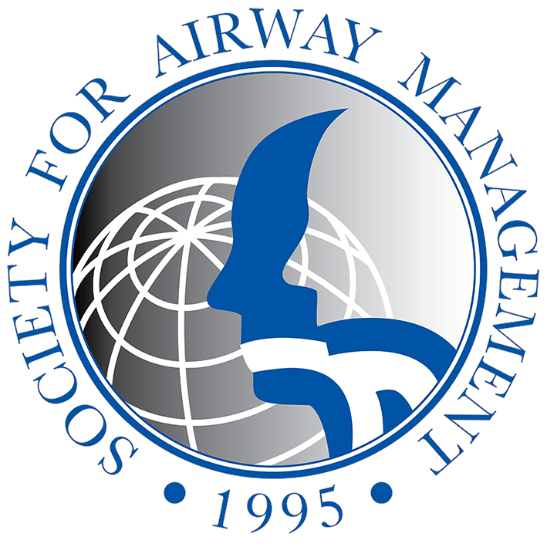
Leading The Way:
Establishing an Airway Lead at Our Hospital
Name, Title, Date
Developed by the Society for Airway Management
Airway Leads Special Project Committee

Slide 2

Overview
Current Challenges in Airway Management
Benefits of an Airway Lead Committee
Roles, Responsibilities & Structure of the Committee
Successes & Future Directions
Notes:
In the brief time we have, we’re going to highlight the current challenges in airway management locally and nationally, the anticipated benefits of a hospital Airway Lead Committee, how such a committee would function, and how creating an Airway Lead Committee at this hospital plays into a larger story of making airway management safer through international Airway Lead Networks.

Slide 3
Significance
Share a Recent Sentinel Event
Provide a Story of Lessons Learned
Notes:
I want to start with a story from a recent sentinel event here at this hospital.
Share a detailed story about a recent sentinel event related to airway management
Describe the incident
Discuss the impact on the patient, staff, and hospital
Highlight what went wrong and any contributing factors
Emphasize the importance of improving airway management to prevent similar events in the future

Slide 4
Opportunities extend beyond isolated events
[Placeholder to insert local data on the prevalence of complications associated with airway management from your institution.]
Notes:
The opportunities to make airway management safer extend beyond isolated events. Here is data from our institution.

Slide 5
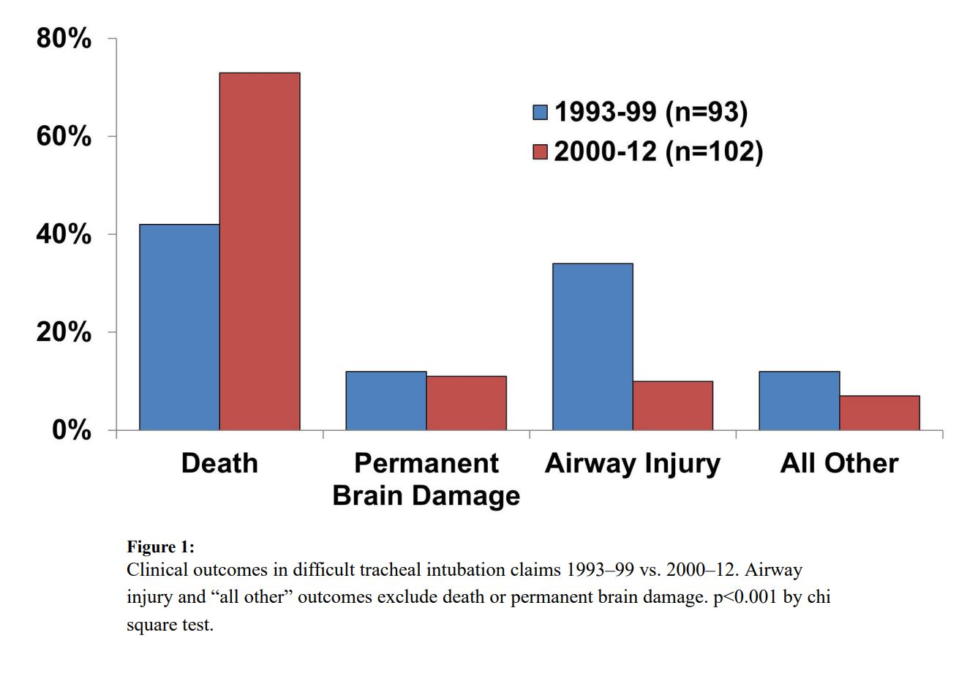
Failed airway management has profound consequences
Joffe et al. 2019
Notes:
Failed airway management has profound consequences. This study of the Anesthesiology Closed Claims database showed that difficult intubations had profound clinical outcomes including death, permanent brain damage and airway injury.

Slide 6
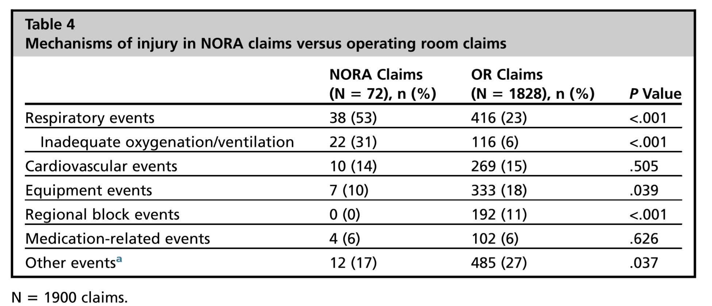
Complications from Respiratory Events are the Most Common Reason for Anesthesiology Legal Claims
Woodward et al 2017
Notes:
Complications from respiratory events are the most common reason for a legal claim against Anesthesiologists. These claims span both the operating room and non-operating room settings. NORA (or non-operating room anesthesia) represents the most drastic growth within anesthesiology practice locations in the past decade and likely in the next as well.

Slide 7
Complications from Respiratory Events
Morbidity and mortality is a universal issue in all areas where advanced airway management is performed.
  Anesthesia (OR and NORA)
  Critical Care
  Emergency Medicine
  Oral Surgery
  Emergency Medical Services
Russotto et al 2021
April et al 2014
Merola et al 2025
Lorenzen et al 2024
Notes:
Critical Care
Russotto V., Myatra S. N., Laffey J. G., et al. Intubation practices and adverse peri-intubation events in critically ill patients from 29 countries. JAMA . 2021;325(12):1164–1172. doi: 10.1001/jama.2021.1727.
EM
April, M., Schauer, S., Nikolla, D., et al. Association between multiple intubation attempts and complications during emergency department airway management: A national emergency airway registry study, AJEM.
2014; 85:202-207. doi.org/10.1016/j.ajem.2024.09.014.
OMFS
Merola, R., Troise, S., Palumbo, D., et al. Airway management in patients undergoing maxillofacial surgery: State of art review, Journal of Stomatology, Oral and Maxillofacial Surgery, Volume 126, Issue 2, 2025, 102044, ISSN 2468-7855, https://doi.org/10.1016/j.jormas.2024.102044.
EMS
Lorenzen, U., Marung, H., Eimer, C. et al. Quality and safety in prehospital airway management – retrospective analysis of 18,000 cases from an air rescue database in Germany. BMC Emerg Med 24, 157 (2024). https://doi.org/10.1186/s12873-024-01075-x

Slide 8
The Financial Burden of Failed Airway Management is Substantial
A medicolegal analysis of claims involving anesthesiologists in a Boston GI suite setting (2007-2016) revealed:
58 claims totaling payouts of $5,785,715
6 payments exceeding $500,000, each involving difficult airway management
Stone et al 2018
Notes:
The financial burden of failed airway management is substantial.
In a medicolegal analysis of claims involving anesthesiologists in a Boston, Harvard-affiliated, GI suite setting (2007-2016), Stone et al (2018) found:
58 claims totaling payouts of nearly $5.8 million dollars
Of these claims, that largest 6 included payouts exceeding $500,000
Notably, the 6 largest payouts involved failed management of the difficult airway, with one requiring front of neck access for ventilation.

Slide 9
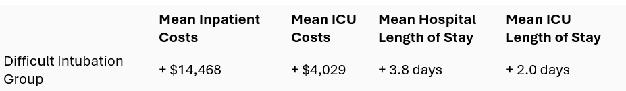
Difficult Intubations are associated with higher hospital costs and LOS
(Compared to patients presenting for inpatient surgical procedures who did not experience a difficult intubation)
Moucharite et al 2021
Notes:
In a study of over 600 patients who had experienced a difficult intubation during an inpatient surgical procedure, Moucharite et al (2021) show that there are increased mean inpatient and ICU costs and mean hospital and ICU lengths of stay for these patients.
The cost was $14,468 higher for inpatients and $4,029 for those admitted to the ICU.
The length of stay was 3.8 days longer for inpatients and 2.0 days longer for those admitted to the ICU.
Airway Leads Committees can increase safety when it comes to intubating patients.

Slide 10
Safety Failures Occur When Many Systems Fail
Training gaps
Policies not know
Lack of equipment familiarity
Aids not available or not known
Distractions
CRM Training gap
Patient Harm
Training
Policies
Equipment
Cognitive Aids
Cognitive Workload
Crisis Resource Management
“Swiss Cheese” Model – James Reason, 1990. The book reference: Reason, J. (1990) Human Error. Cambridge: University Press, Cambridge.
Notes:
I would like to talk briefly about Reason’s “Swiss Cheese Model of Systems”. I would venture a guess that many of you have seen this in HRO training. Generally, those who work in Safety or Quality departments, human factors engineering, or systems analysis are well versed in this. Many at the front line have not seen or heard of this model so I will review it briefly.
The Model: (There is animation to guide you as you go through this discussion)
Slices of cheese = barriers to error
Holes – latent or hidden failures in the system. Failures that do not become apparent until someone is injured or there is an adverse event or close call.

Slide 11
Contributing Factors
Education and Training
Poor performance issues:
Poor technique
Failure to resuscitate, delay in decision making
Failure to recognize risk factors for difficult airway management
Equipment and Resources
Inadequate monitoring
Rescue equipment not available
People not being available
Communication
Failure to working as a team
Stone et al 2018, Cook et al 2011, Asai et al 2019
Notes:
All the reports - ASA closed claims, NAP 4 - state the same contributing factors, gaps in:
Education and training
Equipment and resources
Communication

Slide 12
Airway Management Spans Diverse Practice Locations and Specialties
Intensive Care
Emergency Medicine
Otolaryngology
Nursing &
Respiratory Therapy
Anesthesiology
Airway Management
Notes:
Airway management occurs in diverse practice locations and by clinicians and healthcare professionals from diverse backgrounds including anesthesiology, intensive care, emergency medicine, otolaryngology, nursing, and respiratory therapy.
This also means there are diverse practice patterns, and inconsistent protocols and uptake of emerging evidence and guidelines.

Slide 13
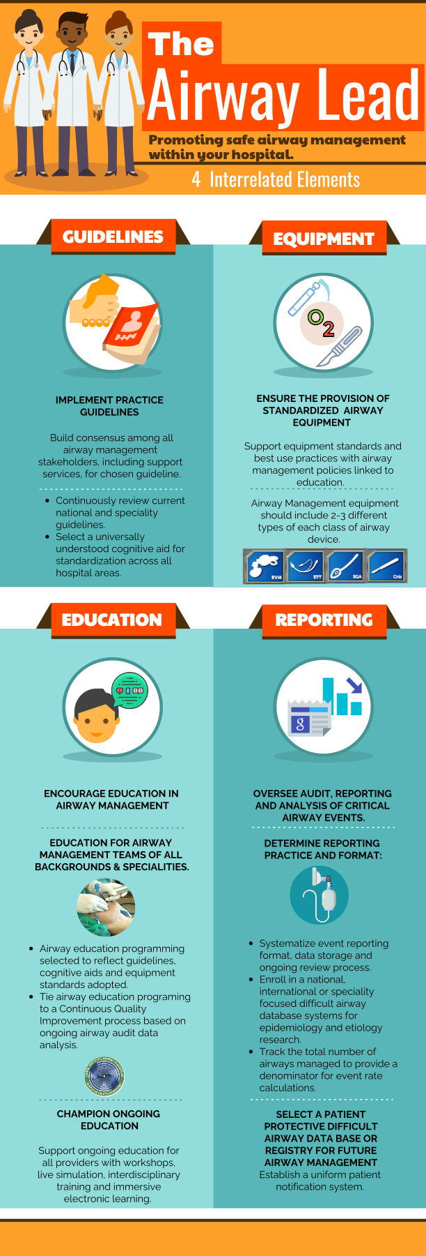
Airway Lead Committee

Slide 14
An Airway Leads Committee Addresses the Challenges in Airway Management
Identifies opportunities for standardization of airway resources
Conducts audits and root cause analyses related to adverse airway events
Creates an interface between airway leaders across the institution
Promotes uptake of current practice management guidelines
Coordinates inter-professional training and education sessions
Baker et al 2022
Notes:
An Airway Leads Committee Addresses the Challenges in Airway Management in at least these 5 ways:
Creates an interface between airway leaders across the institution.
Promotes uptake of current practice management guidelines.
Coordinates inter-professional training and education sessions.
Identifies opportunities for standardization of airway resources.
Conducts root cause analyses related to major airway events.

Slide 15
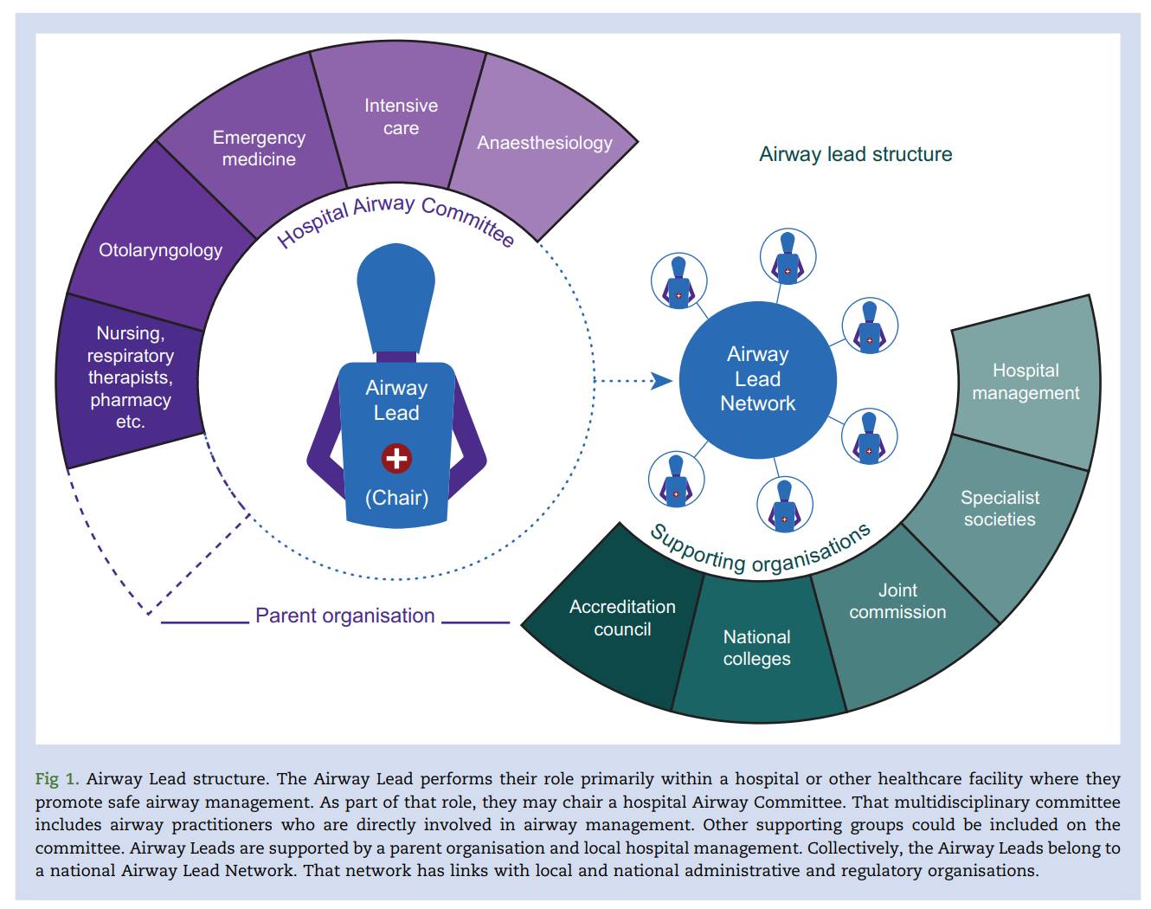
Hospital Airway Committee and Airway Lead Network Structure
Baker et al 2022
Notes:
Here is a diagram from a recently published manuscript on the implementation of an Airway Lead Network in the United States by Baker et al (2022).
Within a hospital, stakeholders in airway management from multiple subspecialities and allied health professions would be assembled on a hospital airway committee, chaired by a single Airway Lead.
Airway Leads from multiple hospitals nationally, with the reinforcement of multiple supporting organizations (including professional societies and regulatory groups), would make up a national Airway Lead Network.
This structure would foster communication between the stakeholders of airway management both locally and nationally, and would create a team to champion airway management and safety initiatives, leveraging the benefits discussed on the previous slide.

Slide 16
Where Have Airway Leads Succeeded Already?
1996: Dr. Adrian Pearce, first secretary of the Difficult Airway Society, and other members, suggest having a person at every hospital responsible for airway management teaching
2011: NAP4 recommends creating an Airway Leads Network. Airway Leads were established in the UK then Ireland, New Zealand, and Australia
2016: A survey of the impact of NAP4 was published:
95% of respondents had an Airway Lead.
4% planned on implementing one.
44% made changes in response to NAP4
2015: Johns Hopkins developed the DART program implementing a multidisciplinary airway team, standardized airway cart and education program.
Cook et al 2011, 2016; Mark et al. 2015, 2018
Notes:
By creating an Airway Lead Committee at this hospital, we would be joining other hospitals not only nationally, but also internationally and across the decades.
1996: Dr. Adrian Pearce, the first secretary of the Difficult Airway Society, and other members suggested having an Airway Representative in every hospital to coordinate and improve airway training and practice. The idea was not adopted widely until the NAP 4 recommendations were publicized. Dr. Pearce promoted airway education in every hospital.
2011: NAP 4 recommends creating an Airway Leads Network.
Following Years: Airway Leads were established in New Zealand, Ireland, and Australia.
2016: A survey of the impact of NAP 4 was published:
95% of respondents had an Airway Lead.
4% planned on implementing one.
44% made changes in response to NAP 4.
2015: John Hopkins developed the DART program:
Multidisciplinary Airway Team.
Standardized Airway Cart.
Educational program.
Between 2008-2013, there were 4738 code activations, with 360 DART triggers and 29 emergency surgical airways performed.
No claims of malpractice, death, or morbidity.

Slide 17
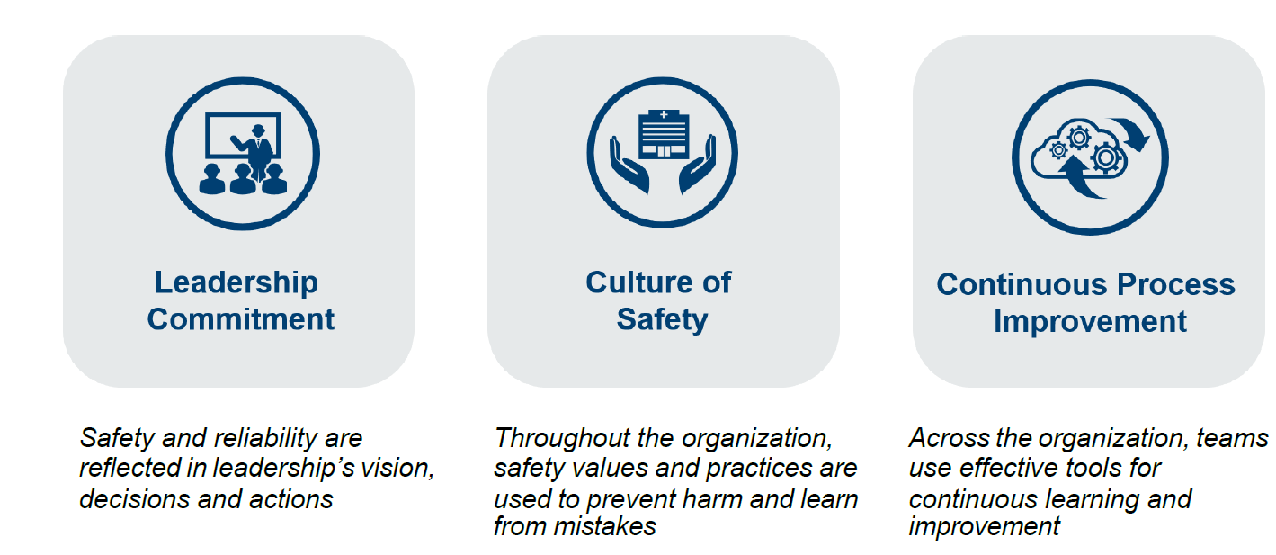
HRO Values
Five Principles
Sensitivity to operations
Reluctance to simplify
Preoccupation with failure
Deference to expertise
Resilience
Schmutz et al 2019, Tankard et al. 2022

Slide 18
Today we are asking that this hospital be part of the next chapter in the history of Airway Lead Networks
Please turn your attention to the handout
Notes:
Today we are asking that this hospital be part of the next chapter in the history of the Airway Lead Network movement.
Please see the handout with our specific asks enumerated.
[Review elements of the handout provided]
For institutions that are not willing to create a stand-alone committee, one strategy is to create a sub-committee of the Code Committee. Once the contributions of the Airway Leads Committee become evident, consider asking to subsequently become a standalone committee.
We are excited to gain your support for this vital patient safety initiative.

Slide 19
Selected
References
Joffe AM, Aziz MF, Posner KL, Duggan LV, Mincer SL, Domino KB. "Management of difficult tracheal intubation: a closed claims analysis." Anesthesiology. 2019 Oct 1;131(4):818-29.
Woodward ZG, Urman RD, Domino KB. "Safety of non-operating room anesthesia." Anesthesiol Clin. 2017 Aug 19;35(4):569-81.
Russotto V., Myatra S. N., Laffey J. G., et al. Intubation practices and adverse peri-intubation events in critically ill patients from 29 countries. JAMA . 2021;325(12):1164–1172. doi: 10.1001/jama.2021.1727.
April, M., Schauer, S., Nikolla, D., et al. Association between multiple intubation attempts and complications during emergency department airway management: A national emergency airway registry study, AJEM. 2014; 85:202-207. doi.org/10.1016/j.ajem.2024.09.014.
Merola, R., Troise, S., Palumbo, D., et al. Airway management in patients undergoing maxillofacial surgery: State of art review, Journal of Stomatology, Oral and Maxillofacial Surgery, Volume 126, Issue 2, 2025, 102044, ISSN 2468-7855, https://doi.org/10.1016/j.jormas.2024.102044.
Lorenzen, U., Marung, H., Eimer, C. et al. Quality and safety in prehospital airway management – retrospective analysis of 18,000 cases from an air rescue database in Germany. BMC Emerg Med 24, 157 (2024). https://doi.org/10.1186/s12873-024-01075-x
Stone AB, Brovman EY, Greenberg P, Urman RD. A medicolegal analysis of malpractice claims involving anesthesiologists in the gastrointestinal endoscopy suite (2007–2016). Journal of Clinical Anesthesia. 2018 Aug 1;48:15-20.
Moucharite MA, Zhang J, Giffin R. Factors and economic outcomes associated with documented difficult intubation in the United States. ClinicoEconomics and Outcomes Research. 2021 Apr 1:227-39.
Swiss Cheese” Model – James Reason, 1990. The book reference: Reason, J. (1990) Human Error. Cambridge: University Press, Cambridge.
Cook T, Harper J, Woodall N. Report of the NAP4 Airway Project. Journal of the Intensive Care Society. 2011;12(2):107-111. doi:10.1177/175114371101200206.
Cook TM, Woodall N, Frerk C. "A national survey of the impact of NAP4 on airway management practice in United Kingdom hospitals: closing the safety gap in anaesthesia, intensive care and the emergency department." BJA: British Journal of Anaesthesia. 2016 Aug 1;117(2):182-90.
Asai T, Hillman D. Current Difficult Airway Management—Not Good Enough!. Anesthesiology. 2019 Oct 1;131(4):774-6.
Baker PA, Behringer EC, Feinleib J, Foley LJ, Mosier J, Roth P, Wali A, O'Sullivan EP. "Formation of an Airway Lead Network: an essential patient safety initiative." British Journal of Anaesthesia. 2022 Feb 1;128(2):225-9.
Mark LJ, Herzer KR, Cover R, Pandian V, Bhatti NI, Berkow LC, Haut ER, Hillel AT, Miller CR, Feller-Kopman DJ, Schiavi AJ. "Difficult airway response team: a novel quality improvement program for managing hospital-wide airway emergencies." Anesthesia & Analgesia. 2015 Jul 1;121(1):127-39.
Mark L, Lester L, Cover R, Herzer K. "A decade of difficult airway response team: lessons learned from a hospital-wide difficult airway response team program." Critical care clinics. 2018 Apr 1;34(2):239-51.
Schmutz J, Meier LL, Manser T. How effective is teamwork really? The relationship between teamwork and performance in healthcare teams: a systematic review and meta-analysis. BMJ Open. 2019;9(9):e028280. doi:10.1136/bmjopen-2018-028280.
Tankard KA, Sharifpour M, Chang MG, Bittner EA. Design and Implementation of Airway Response Teams to Improve the Practice of Emergency Airway Management. J Clin Med. 2022 Oct 27;11(21):6336.
Notes:
References in order of appearance in the presentation.

Slide 20
The Society of Airway Management is here to help
What comes next?​
​
Join the Society for Airway Management ​
Engage in the DocMatter Community forum through the Society for Airway Management ​
Register your Airway Leads Committee here
Notes:
This slide is to help guide new Airway Leads creators. The Society for Airway Management is here to help.
We invite one or more members of your airway leads committee to join the Society for Airway Management. This will give you access to a broad range of resources including the Doc Matter forum, a community thread about challenges and resources in airway management and an opportunity to post and receive feedback about your experiences with an Airway Leads Committee. Please also register your Airway Leads Committee with us using form above so you can receive support from our group.
Airway Leads Committees do not stand alone but instead work in concert with each other in the form of an Airway Leads Network to leverage advances and improve patient safety together.

Slide 21

SAM’s Airway Leads Network
Complete this form to join and be invited to virtual events.
Notes:
Please complete this form if you wish to be included in the Society of Airway Management’s Airway Leads Network Database, and be invited to virtual events.

Slide 22
Discussion

