Slide 1

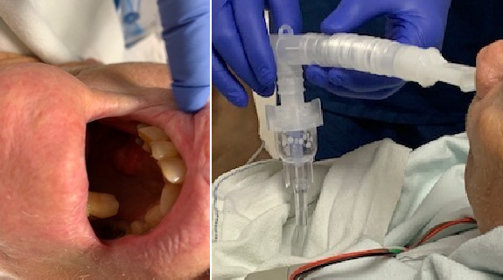
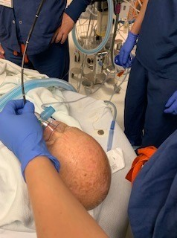
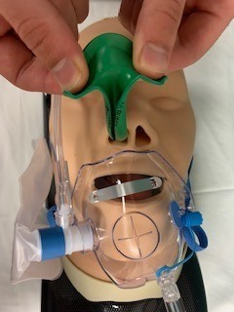
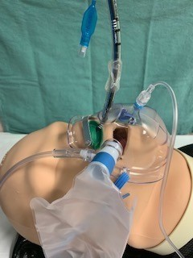
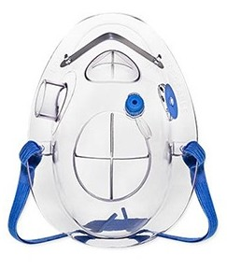
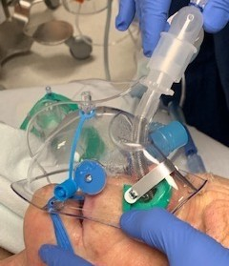
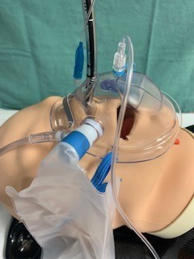
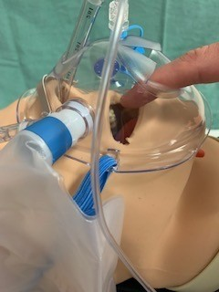

Nasal flexible intubation with POM mask
Sharma I, Farson L, Roland G, Williams UU, Kwater A, Donahue H, Zavala A, Hancher-Hodges S, Casarez V and M Ramirez
MD Anderson Cancer Center Division of Anesthesiology & Perioperative Medicine
Introduction
The 2022 ASA difficult airway guidelines recommend supplemental oxygen administration throughout all the phases of airway management including intubation and extubation to improve safety, particularly in patients with an anatomically difficult airway. Various devices such as nasal cannula and HFNO have been used for oxygen delivery before and during the intubation.
Procedural Oxygen Mask® (POM) is a novel versatile multiport mask that allows the fiberscope to be inserted through the mask while maintaining high FIO2 delivery to the patient (Fig. 1). We describe a case report of a patient in whom a POM was used to maintain oxygenation throughout the procedure of awake nasal flexible scope intubation.
a
b
c
a
b
a
Figure 3 The Procedural Oxygen Mask® is FDA approved and has ports for scopes, an oxygen reservoir bag, and for capnographic sampling.
c d
Figures 2a-d Steps of performing a nasal intubation on a mannequin with a Procedural Oxygen Mask®. Fig. 2a Application of the nasal trumpet to guard the scope from secretions. Fig. 2b Fitting of POM to the patient’s face and insert fiberoptic endoscope guided endotracheal tube. Fig. 2c Removal of nasal trumpet and Insertion of the endotracheal tube. Fig. 2d Removal of the guide endoscope. The additional ports in the POM enable other devices to be simultaneously used.
Case Report
A 67-year-old gentleman with a history of squamous cell carcinoma of the gums and a known difficult airway was scheduled for an EGD for vomiting when receiving PEG feedings. The patient was preoxygenated with the POM mask with a reservoir attached to the side port of the mask and a flush flow rate of 15 liters per minute oxygen. This configuration has been shown to provide up to 80 to 90% FiO2. A nasal trumpet cut lengthwise was inserted in the left nostril of the patient (size 32). Topical anesthesia was administered by nebulization of 4% lidocaine, and a flexible fiberscope was inserted through the nasal port of the POM and passed through the left nostril of the patient. The glottic opening was visualized with aid from a jaw thrust, and the patient was intubated using a size 6.5 nasal ET tube. The patient remained comfortable during the procedure and maintained an oxygen saturation of 100% throughout.
d
Figure 1a Squamous cell carcinoma of the gums creating a difficult to access airway in the 67-year-old patient. Fig. 1b Nebulizer by which the patient received lidocaine. Fig. 1c Flexible fiberscope inserted into the patient via the POM’s nasal port. Fig. 1d Nasal flexible intubation.
Discussion
The 2022 American Society of Anesthesiologists Practice Guidelines for Management of the Difficult Airway maintained their recommendation of administering supplemental oxygen before initiating management of the difficult airway and to continue to deliver supplemental oxygen whenever feasible throughout the process of difficult airway management, including extubation.
Several devices can be used for oxygenation including nasal prongs, facemasks, or supraglottic insufflation devices.
A POM is a mask that allows access to the nose and the mouth for instrumentation during intubation.
Advantages include: 1) the insertion of different types of scopes, probes, and tubes 2) the measurement of end tidal capnography and 3) the oxygen delivery during difficult intubation. POM ports are self-sealing and are in an open configuration only during the time of active instrumentation, thus allowing for a tight seal on the face, which is useful to achieve de-nitrogenation of the FRC during pre-oxygenation. The mask also allows for attachment of a reservoir to minimize entrainment of room air and can provide an Fi02 delivery rate of 0.88 to 0.95. A POM provides an excellent alternative for maintaining uninterrupted high flow oxygen delivery even during the actual intubation procedure. Additionally, it provides effective protection from coughing and secretions due to its coverage of the face. It is also a cheaper alternative to other high flow oxygen delivery devices such as HFNO or a positive pressure ventilation mask. There are no large-scale studies that report the use of this mask during intubation.
Conclusions
The POM is a safe and effective device for maintaining oxygenation during awake intubation of patients with difficult airways. More clinical and physiological studies are warranted to delineate its use in this setting.
References
1. Apfelbaum JL, Hagberg CA, Connis RT, et al. 2022 American Society of Anesthesiologists Practice Guidelines for Management of the Difficult
Airway. Anesthesiology. 2022;136(1):31-81. 2. Gonzalez RM. Maximizing Patient and Staff Safety During Transesophageal Echocardiography in the COVID-19 Era by Use of a New
Oxygen Delivery System: Endoscopy Oxygen Masks with Self-Sealing Endoscope Insertion Ports. J Am Soc Echocardiogr. 2021;34(4):453-454. 3. Gonzalez RM. A Practical Guide for Anesthesia Providers in the Endoscopy Suite During the Coronavirus Disease 2019 Pandemic: Unmitigated Coughing and Aerosol Generation During Open-Face Endoscopies. Anesth Analg. 2021;133(2):e29-e30.

Slide 2
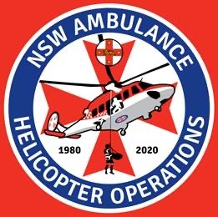

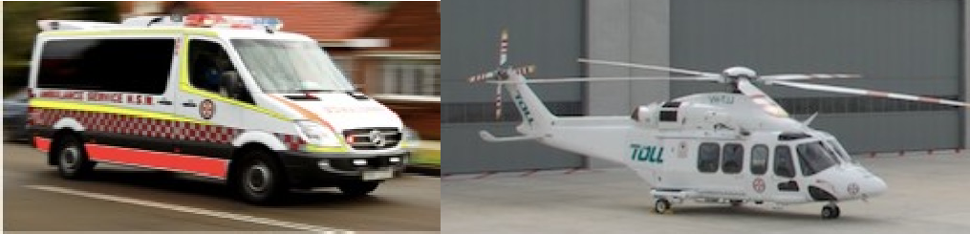

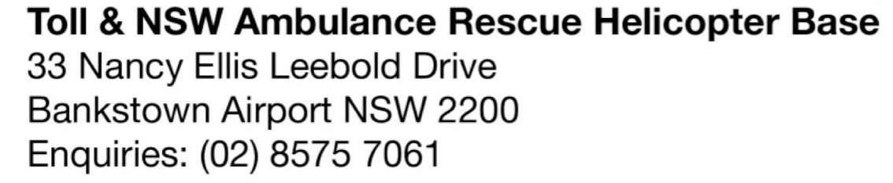

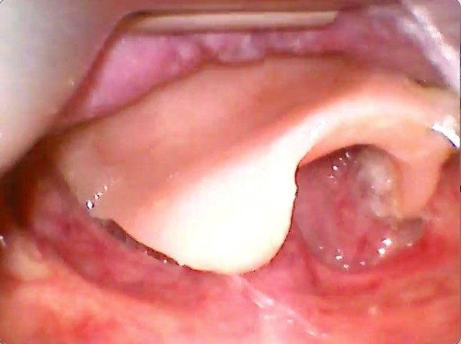
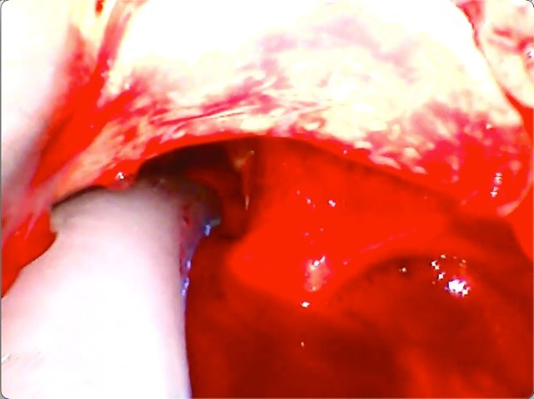

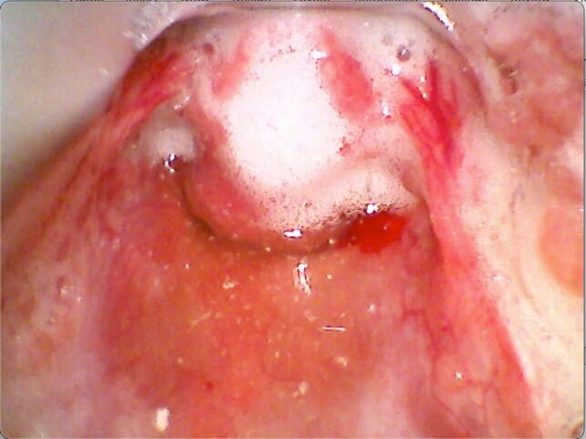
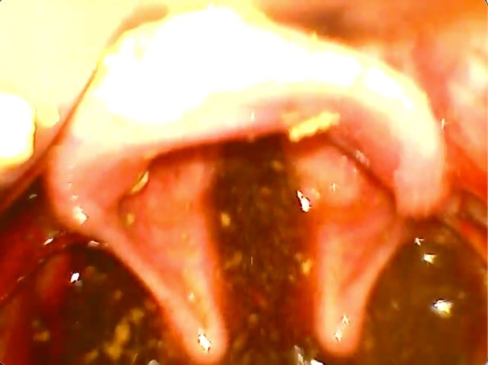

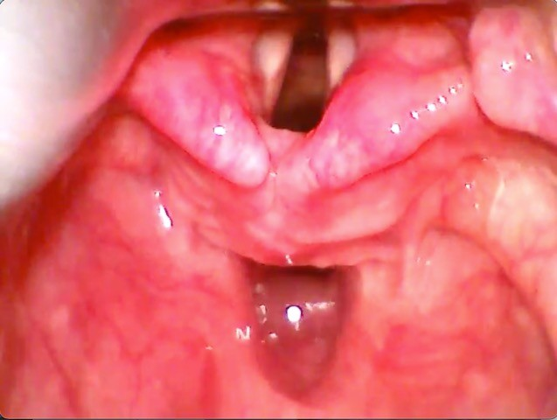
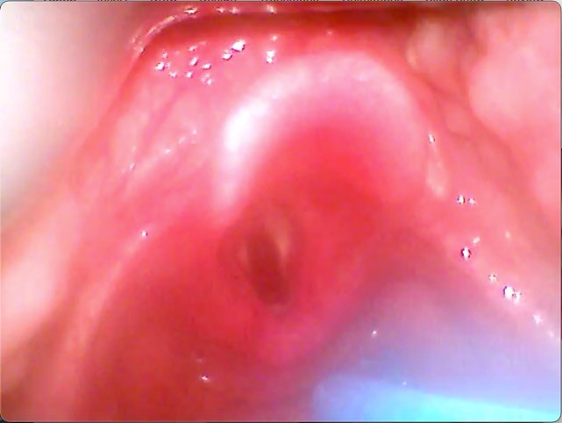

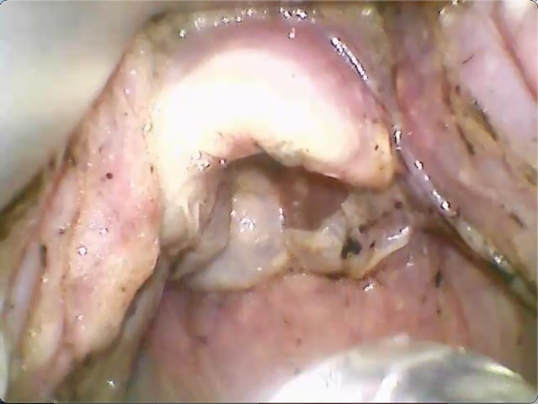
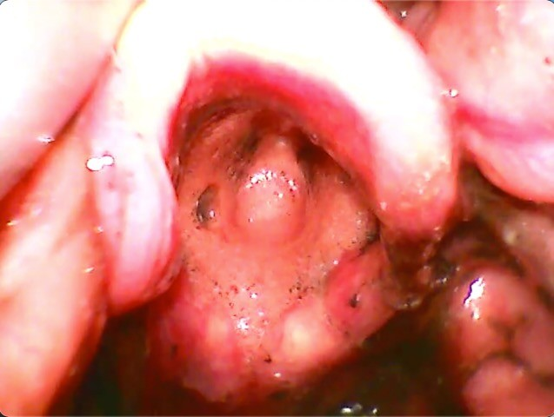
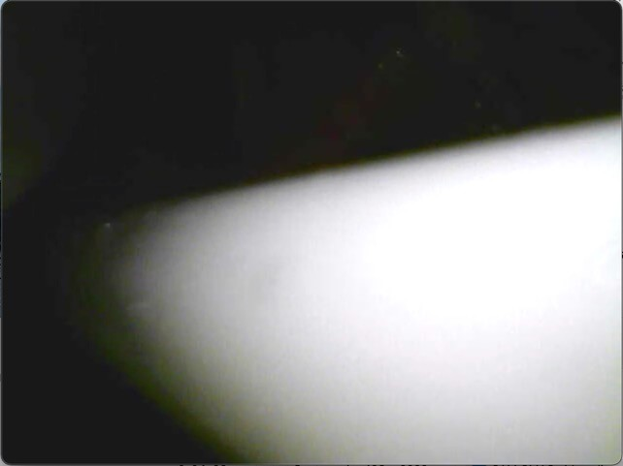
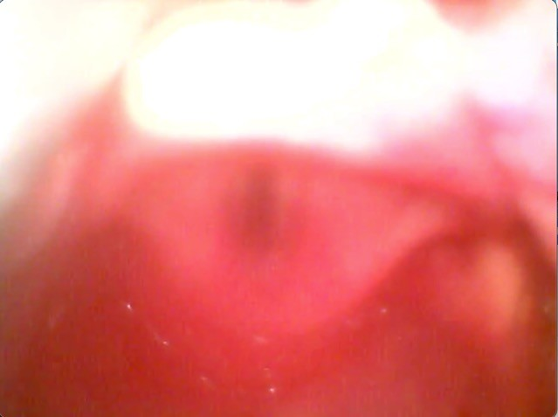
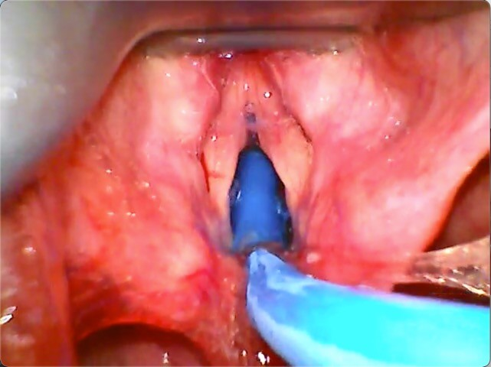
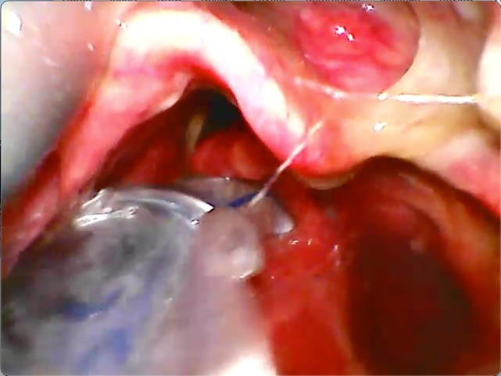
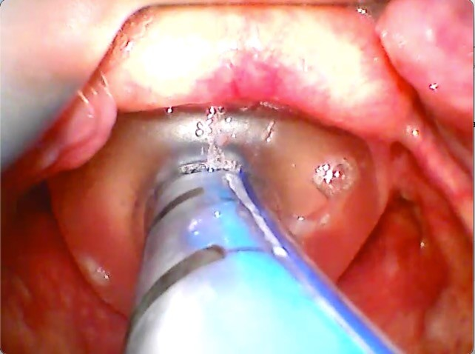
Clare Hayes-Bradley & Hugo Gemal Prehospital & Retrieval Doctors NSW Ambulance, Australia.
C. Hayes-Bradley, H. Gemal, M. Miller, S. Ware. Prehosp Disaster Med. 2022 Aug; 37(4): 485–491.
Case Series:
Benefits of Videolaryngoscopy review
CMAC Pocket Monitors (Karl Storz, Germany), Macintosh blade 4 retrospective study ethics approval 6457- 2020/ETH00981 Western Sydney LHD HREC.
EDUCATION
PATHOLOGY
Clinical Governance monthly review of database videos brought many extra benefits.
How could video review help your department?
EQUIPMENT
Dentures
Blood
EDUCATION
TECHNIQUE
Soiled – fluid & froth
Soiling
Blood on lens
a) under epiglottis
b) Relocated vallecula
Burns - slough
Blackout
Fogging
Bougie impact
Burns - inhalation
Parker tip catch
Cuff herniates
We acknowledging the Darug & Eora people, traditional custodians of the land on which this knowledge was gained and pay our respects to their Elders past and present.
clarehayesbradley@yahoo.com
@ClareHBradley
No conflicts of interest to declare
23rd Annual SAM scientific meeting Tucson, Arizona Sep 15-18 2022

Slide 3
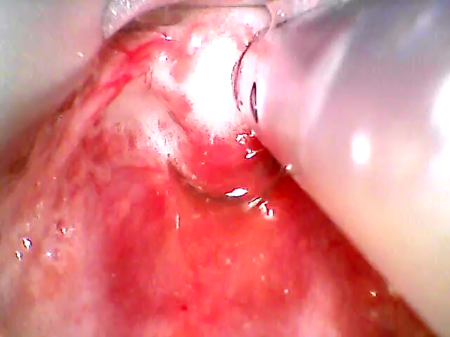

Slide 4
Clare Hayes-Bradley & Hugo Gemal Prehospital & Retrieval Doctors NSW Ambulance, Australia.
C. Hayes-Bradley, H. Gemal, M. Miller, S. Ware. Prehosp Disaster Med. 2022 Aug; 37(4): 485–491.
Case Series:
Benefits of Videolaryngoscopy review
CMAC Pocket Monitors (Karl Storz, Germany), Macintosh blade 4 retrospective study ethics approval 6457- 2020/ETH00981 Western Sydney LHD HREC.
EDUCATION
PATHOLOGY
Clinical Governance monthly review of database videos brought many extra benefits.
How could video review help your department?
EQUIPMENT
Dentures
Blood
EDUCATION
TECHNIQUE
Soiled – fluid & froth
Soiling
Blood on lens
a) under epiglottis
b) Relocated vallecula
Burns - slough
Blackout
Fogging
Bougie impact
Burns - inhalation
Parker tip catch
Cuff herniates
We acknowledging the Darug & Eora people, traditional custodians of the land on which this knowledge was gained and pay our respects to their Elders past and present.
clarehayesbradley@yahoo.com
@ClareHBradley
No conflicts of interest to declare
23rd Annual SAM scientific meeting Tucson, Arizona Sep 15-18 2022

Slide 5


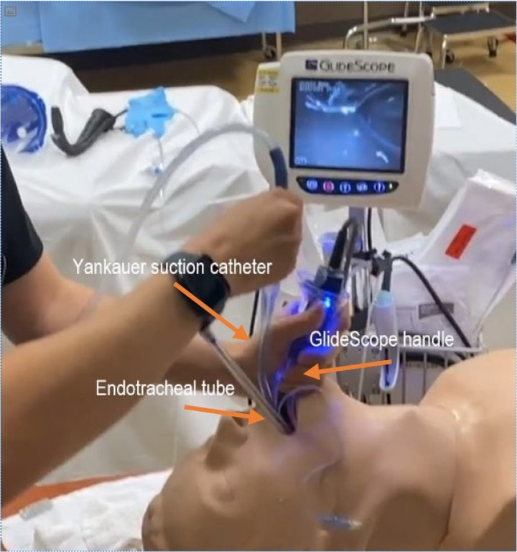
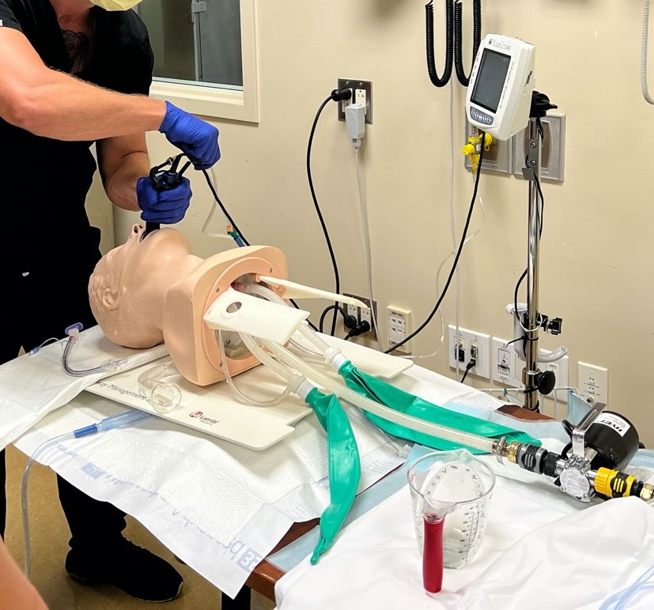
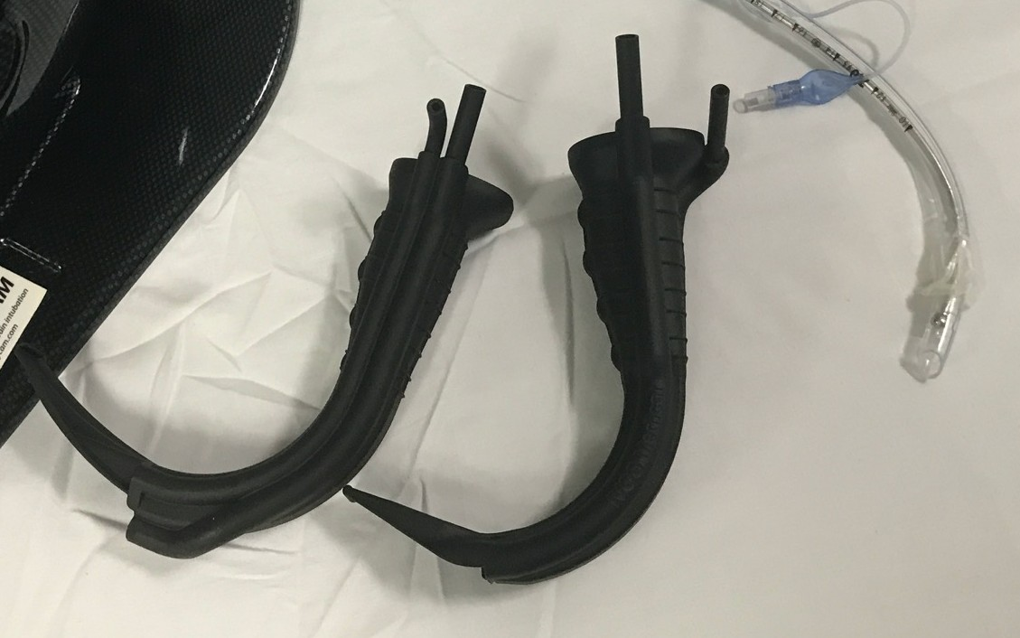

A Novel 3D-printed Video Laryngoscope for Minimizing Aspiration During Emergent Intubations
Waylan Wong, MD, MS; Gabriel Punsalan, CRNA, MS
Department of Anesthesiology & Perioperative Care, University of California, Irvine
Introduction
Video laryngoscopes - secretions obscure camera, leading to delayed intubation, aspiration, hypoxia, death.
Aspiration incidence up to 22% during rapid sequence intubation in the ED (1).
We created a 3D-printed Glidescope sleeve, IVOS Boss G4, with a suction channel and air channel that removes secretions, thereby clearing the lens.
We tested our IVOS Boss G4 sleeve against the Glidescope AVL 4 © using a simulated vomiting manikin.
Methods
Single center, IRB-exempt, randomized, comparative study examining intubation times between the IVOS Boss G4 vs Glidescope AVL4
54 subjects (UCI EM & anesthesia residents, CRNAs) with > 100 successful intubations
Timed intubation in both unsoiled and soiled manikins
Outcomes: Intubation time (seconds), lung aspirate
(mL), first pass success (%)
Statistical analysis: T-test, chi-square test
Results
 | AVL4 w/ Yankauer | IVOS Boss G4
Avg unsoiled (seconds) | 11.75 (SD 7.84) | 12.17 (SD 6.61)
Avg soiled (seconds) | 89.57 (SD 43.23) | 67.01** (SD 25.31)
Avg lung aspirate (mL) | 109.20 (SD 50.02) | 86.91** (SD 42.62)
First pass success rate soiled (%) | 77.8 | 98.2**
** - p-value < 0.01
Suction port
IVOS Boss sleeve
Conclusions
Compared to the Glidescope AVL4, the IVOS BOSS G4 significantly reduced intubation time and aspiration volume while improving first pass success rate in a simulated vomiting manikin.
O2
channel
Emesis Pump
References
1. Fiore et al. Three Airway Management Techniques for Airway Decontamination in Massive Emesis: A Manikin Study. West J Emerg Med. 2019;20(5):784-790.
Figure 1. Time unsoiled intubation with Glidescope AVL4
Figure 2. Timed intubation with IVOS Boss G4 in vomit manikin
IVOS Boss G4 Glidescope sleeve (prototype 2 &3)
* Funded entirely by NHBLI SBIR Phase I grant #R43 HL164325. Statements/conclusions may not represent the views of the NIH.*

Slide 6

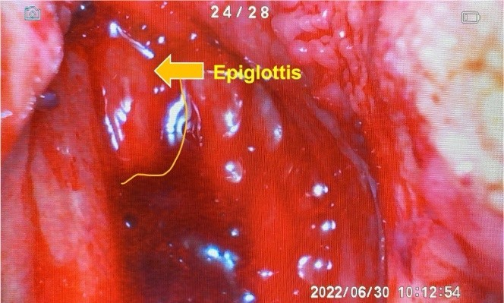
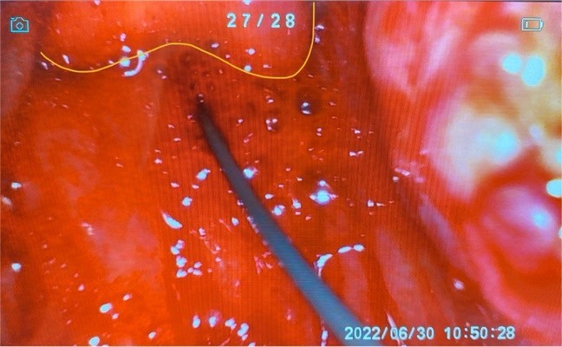
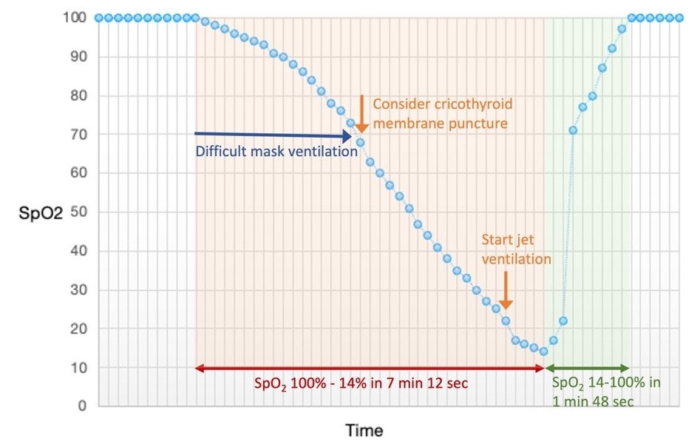
Retrograde Tracheal Intubation in Patient Post-Neck Radiation After Multiple Attempt of Failed Intubation: A Case Report
Yutthapon Panyakhamlerd*, M.D., Boonsam Roongpuvapaht**, M.D.
*Department of Anesthesiology, **Department of Otolaryngology, Faculty of Medicine Ramathibodi Hospital, Mahidol University, Bangkok, Thailand.
BACKGROUND
The airway-related consequences of post-neck radiotherapy in head and neck cancer patient always challenging the airway management. Neck radiotherapy may cause fibrosis of soft tissue and joint, leading to difficult laryngoscopy and intubation. This case report is intended to increase awareness on the myriad of airway problems to be anticipated and the decision making to successfully secure the airway.
CASE PRESENTATION
This case report was approved by IRB. A 58-year female with diagnosis of nasopharyngeal tumor scheduled for endoscopic sinus surgery and tumor removal. She had chemo-radiation 5 years ago.
Airway examination revealed Mallampati III, limited
mouth opening and neck extension. Anesthesia was induced with propofol and succinylcholine. Non- invasive airway management attempts were done as following: VL-aid Bonfil fiberscope intubation, VL with Frova introducer, and FOB. All attempts were failed but mask ventilation still adequate. Then the upper airway bleeding and difficult mask ventilation was noticed while SpO₂ was decreased progressively. The emergency cricothyroid membrane puncture and jet ventilation was performed, the SpO₂ rapidly increased. Retrograde wire insertion and using ETT exchanger over the guide wire passing through the laryngeal inlet then railroaded the ETT to the trachea. The EtCO₂ was detected, and FOB was performed to reassure the ETT position.
DISCUSSION
Even successful intubation but there are many pitfalls such as no effective airway assessment, not follow the algorithm, and not limit number of attempts and time usage until the situation turn to critical. The skill of invasive airway access procedure is crucial and need practice.
REFERENCES
Bagam KR, Murthy SGK, Vikramaditya C, Jagadaesh V. Retrograde intubation: An alternative in difficult airway management in the absence of a fiberoptic laryngoscope. Indian J Anaesth. 2010; 54(6):585.
Apfelbaum JL, Hagberg CA, Connis RT, Abdelmalak BB, Agarkar M, Dutton RP, et al. 2022 American society of anesthesiologists practice guidelines for management of the difficult airway. Anesthesiology. 2022; 136:31-81.

