Slide 1
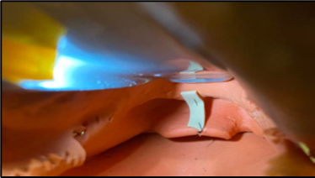
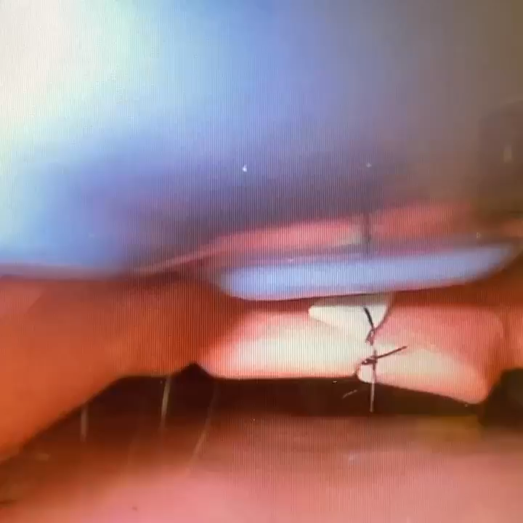
Modification to airway training mannequin to improve engagement of the hyoepiglottic ligament
Rick Tumminello, DO
Department of Emergency Medicine, Einstein Medical Center Philadelphia
Background
Case Presentation
Discussions
The hyoepiglottic ligament, located within the midline vallecular fold (MVF), has been championed for its ability to improve glottic inlet visualization upon engagement with the laryngoscope blade further supported by the recent publication of a retrospective video review.¹ Unfortunately, engagement of the MVF is often not highlighted during intubation training in emergency medicine residencies. While simulation has played an essential role in enhancing trainees’ airway skills, current airway trainers lack an engageable MVF resulting in a missed opportunity to teach airway anatomy and practice engagement of the fold in a safe and controlled setting.²
This study was exempt from approval by IRB and local review board. An airway trainer was modified by suturing in place a rubber band to the vallecula and the base of the epiglottis representing the MVF (Figure 1). Figure 2 shows superior glottic visualization with simulated MVF engagement resulting in epiglottic elevation. This proposed modification can elevate trainees' education by 1) having a visual cue and reminder of the anatomic structures and 2) learning how to appropriately place the blade tip, engage the MVF, and improve their laryngeal view.
This model modification, combined with Driver et al. findings, can further emphasize the engagement of the MVF and improve laryngeal visualization in emergency medicine training through simulation. This author was unable to find an existing airway trainer with an engageable MVF. This is a simple modification which can educate trainees and result in safer outcomes for patients.
Acknowledgements
Special thanks to John Hoffman, BSN, NRAEMT and Einstein Simulation Center for donated airway trainer.
References
Driver BE, Prekker ME, Levitan RM, et al. Engagement of the Median Glossoepiglottic Fold and Laryngeal View During Emergency Department Intubation. Ann Emerg Med 2021;78(6):699-707.
Yang, D., Wei, YK., Xue, FS. et al. Simulation-based airway management training: application and looking forward. J Anesth 2016; 30, 284–289.
Figure 1: Rubber band sutured in place to the vallecula and base of the epiglottis representing the midline vallecular fold.
Figure 2: Figure 2 shows video of improved glottic visualization with glottic elevation upon engagement of simulated midline vallecular fold

Slide 2
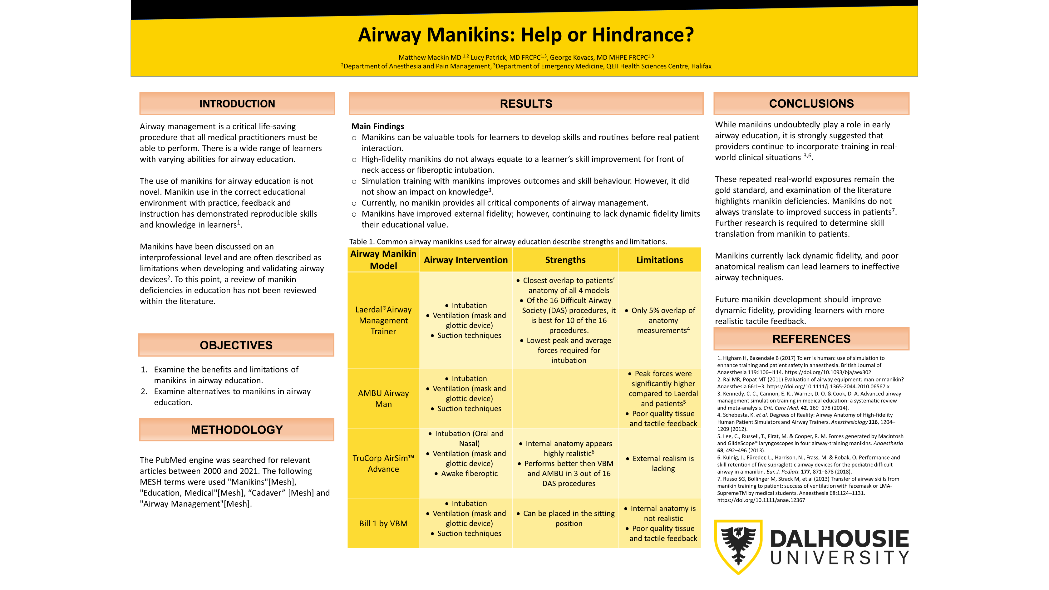

Slide 3
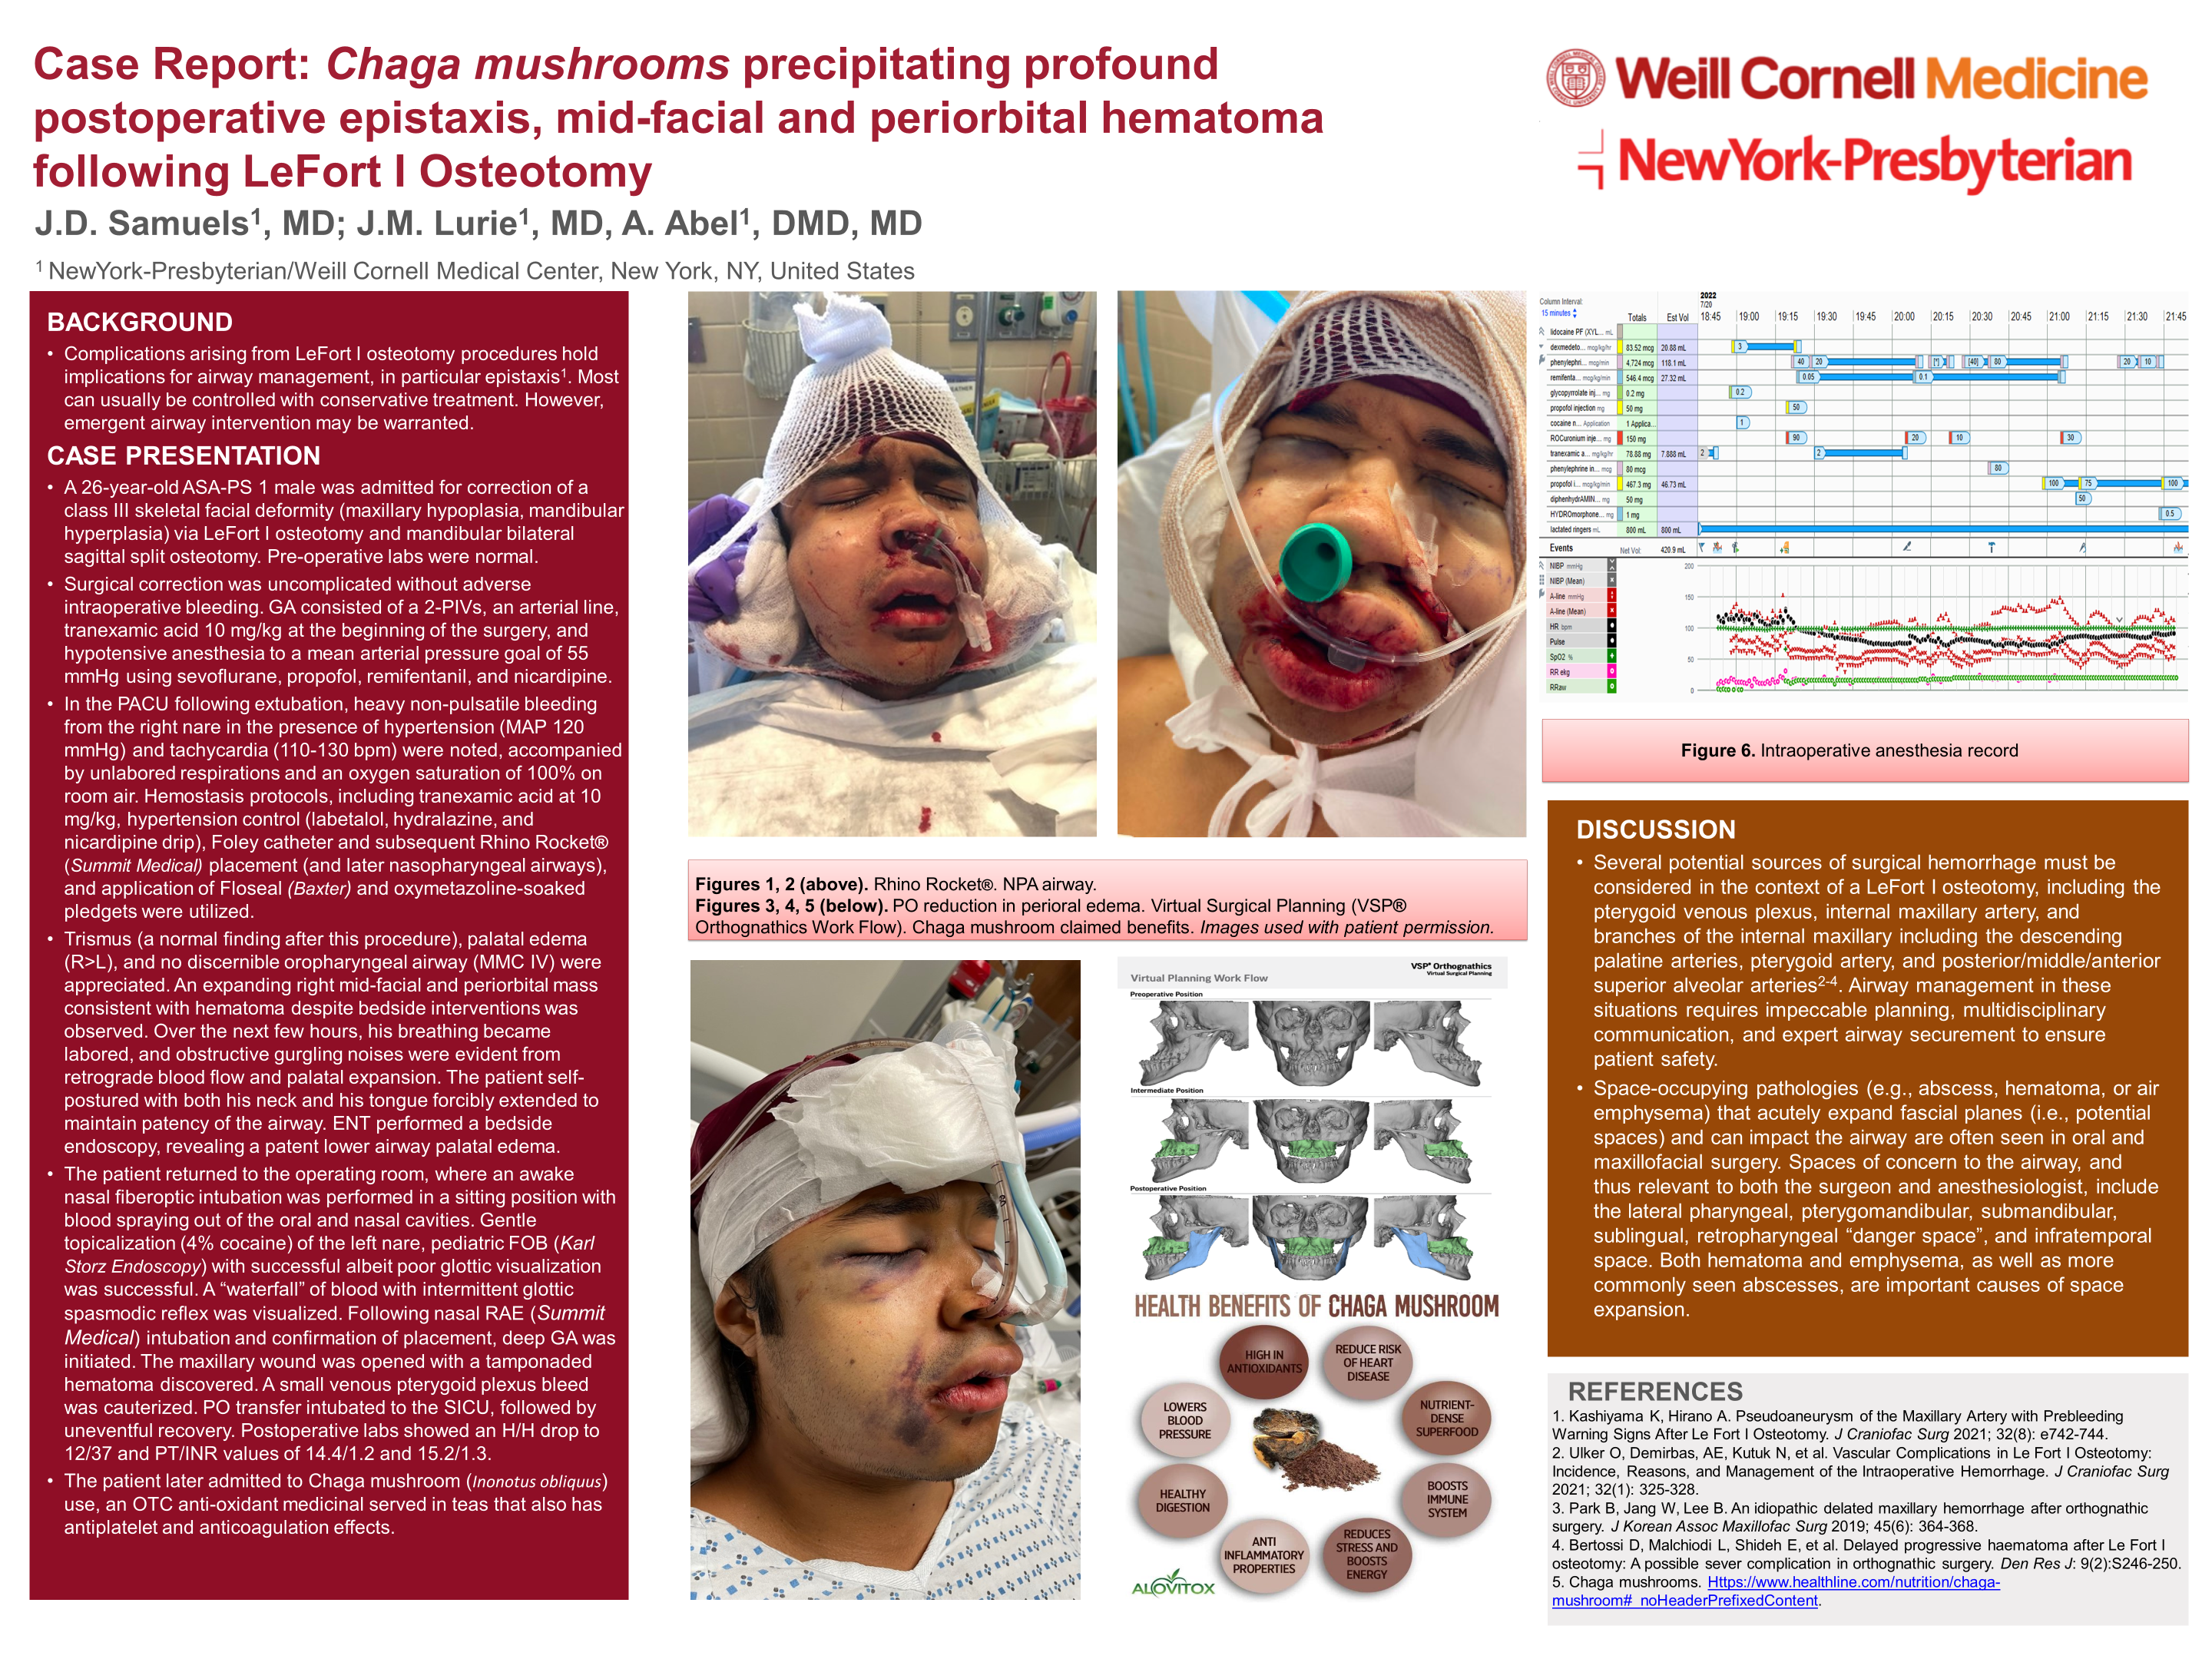

Slide 4
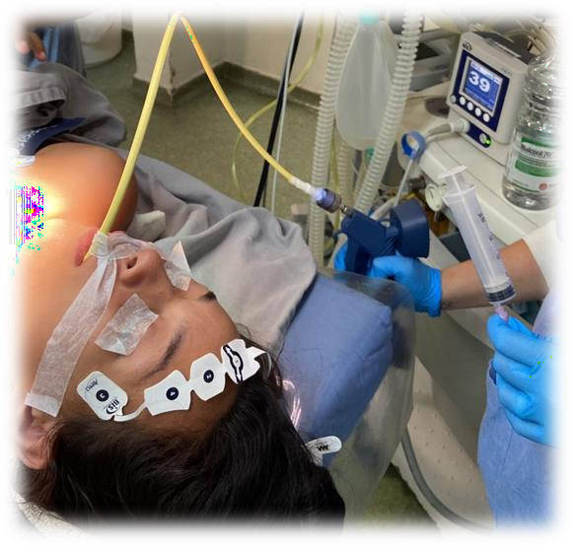
CASE REPORT: JET VENTILATION THROUGH AN AEC FOR TRACHEOPLASTY.
Prado RG, Scarduelli PLF, Malito LM, Perin D, Ramos MS, Amaral Neto, M.
Background: Tracheal stenosis is normally a complication due to prolonged intubation.
Case Presentation: 21yrs, female patient, BMI: 19, ASA P2 with important tracheal stenosis after prolonged intubation and convulsions. The patient was preoxygenated and induced intravenously with sufentanil (TCI-0,3ng/ml),
Discussion:
The ventilation through an
airway exchange catheter
needs precautions but allows
good conditions for the surge-
on to view and operate a tracheal stenosis. Complications as pneumothorax or barotrauma are dangerous and the challenge is do decide which patient is eligible for this technique.
lidocaine (100mg), propofol (TCI-2,5ug/ml),
diazepam (5mg) and rocuronium(50mg). DL was unsuccessful performed with a 7,0 and 5,5 TT. An airway exchange catheter (AEC) was introduced with DL and MANUJET ventilation was started (2,5 psi, RR 10-12). Arterial blood gases were controlled every 15 minutes during the 60 minutes surgery. After the procedure, sugamadex (200mg) was administered guided by TOF and the patient was fully awake and eupneic.
References:
Macedo Neto AV, Oliveira HG, Macedo BR et al. Tratamento endoscópico das estenoses funcionais das vias aéreas. Disponível em www.sopterj.com.br/wp- content/themes/_sopterj_redesign_2017/_revista/2011/n_02/03.pdf
Li S, Liu Y, Tan F E et al. Efficacy of manual jet ventilation using Manujet III for bronchoscopic airway foreign body removal in children. Int J Pediatr Otorhinolaryngol. 2010 Dec;74(12):1401-4.

Slide 5
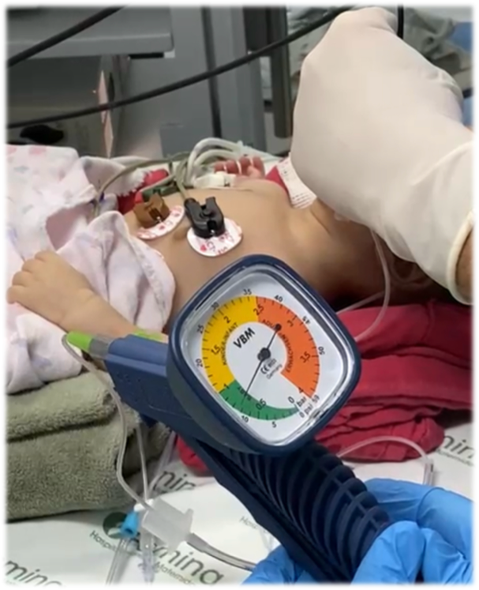
SUSPECTED TRACHEOMALACIA IN 2 MONTHS INFANT WITH PULMONARY HYPERTENSION AND PIERRE ROBIN SYNDROME.
The procedure was done, and the patient went to ICU ventilating spontaneously.
Prado RG, Sales LHB, Malito LM, Perin D, Ramos MS, Amaral Neto, M.
Background: Anesthesia for nasal endoscopy procedures in infants is a stressful event even for experienced anesthesiologists.
Discussion: The ventilation for nasal endoscopy procedures in infants is challenging, specially with comorbidities. The use of a nasogastric tube and jet ventilation was an alternative in this case.
Case Presentation: 2 months, female patient, ASA P3 with
patent foramen ovale (PFO) and pulmonary
hypertension(PAP=65mmHg) with suspected tracheomalacia
and Pierre Robin Syndrome was submitted to a nasal
endoscopy for diagnosis. After preoxygenation, general iv
References:
Rodrigues JT, Oliveira C, Ferreira AP. High frequency jet ventilator – a new approach in the management of anesthesia for pediatric cardiac magnetic resonance imaging: case series. Braz J Anesthesiol. 2019; 69(6):626-30.
Li S, Liu Y, Tan F E et al. Efficacy of manual jet ventilation using Manujet III for bronchoscopic airway foreign body removal in children. Int J Pediatr Otorhinolaryngol. 2010 Dec;74(12):1401-4.
anesthesia was induced (sufentanil 0,1mcg/kg, propofol 1mg/kg, dexmedetomidine 0,3mg/kg and propofol bolus as needed) and intubated with 3,0 TT and DL. A small nasogastric tube was introduced inside the tube and TT was removed. Jet ventilation (Manujet III) performed via NGT (1,5psi RR20/min).

