Slide 1

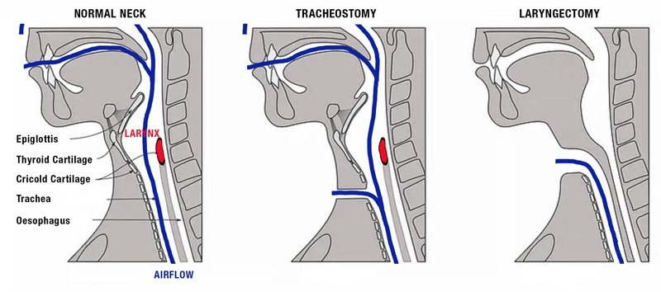
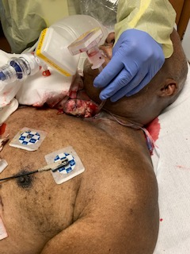
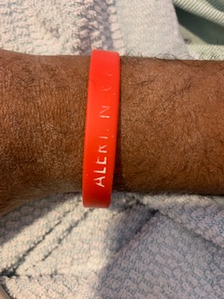
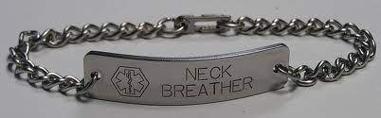
Quality Improvement Project for Patients with Tracheostomy/Laryngectomy for Emergency Airway Events
Vu C, Sharma I, Zavala A, Idowu T, Kwater AP, Donahue H, Oliver JA, Bankston CB, Panchapakesan K, and Singh-Heir J
Introduction
Case Report
Discussion
Most emergency medical staff cannot differentiate between partial neck breathers (patients with tracheotomy) and total neck breathers (following laryngectomy) (Figure 1). Each patient type requires a different approach to airway management, which becomes especially challenging when the patient is in respiratory distress and cannot communicate. A medical bracelet stating “neck breather” may be the only way for emergency staff to identify these patients. We present a case in which the medical bracelet, although present, had lettering that was not clear and ultimately resulted in incorrect initial airway management during an an emergency event.
A 59 year-old man with a history of squamous cell carcinoma s/p laryngectomy developed acute respiratory distress secondary to mass effect from the recurrent carcinoma. Rapid response team was initiated:
Respiratory therapist initially applied face mask to oxygenate, unaware of the patient’s prior laryngectomy due to stomal mass obstruction
After obtaining a brief medical history, the anesthesiologist manually displaced the mass to identify a stoma site
Utilizing finger palpation for guidance, a 5.5 mm cuffed endotracheal tube was successfully placed through the stoma (Figure 3-A)
Endotracheal tube secured at 11 cm to avoid main stem intubation
On further evaluation, patient was wearing a “neck breather” bracelet, but the letters were faded and difficult to read (Figure 3-B).
Patients with prior tracheotomy or laryngectomy can present similarly in regard to a trach/stoma site. Differentiating these clinical presentations is critically important as airway management differs significantly. In our case, the patient is a total neck breather, and thus his trachea has no connection to the upper airway. Therefore, all airway exchange occurs through the stoma site. Emergency staff did not recognize this critical fact because the tumor partially occluded his stoma site and the patient was also unable to communicate. The medical bracelet was a key component in identifying the patient as a total neck breather, but unfortunately the lettering was faded. For post-laryngectomy patients, we propose a series of recommendations to ensure proper airway management in emergency events:
Place medical bracelet on the same arm as the ID wristband
Consider using a metal bracelet with engraved lettering (Figure 2)
Recommend providing a new hospital bracelet on each admission
Consider using a sign placed at bedside with airway management documentation to provide accessible and vital clinical information
Clinical Figures
(A)
(B)
References
Darr A, Dhanji K, Doshi J. Tracheostomy and laryngectomy survey: do front-line emergency staff appreciate the difference? J Laryngol Otol. 2012 Jun;126(6):605-8
Brook, Itzhak MD, MSc. Ventilation of Neck Breathers Undergoing a Diagnostic Procedure or Surgery, Anesthesia & Analgesia: June 2012 - Volume 114 - Issue 6 - p 1318-1321
Brook I. Ensuring adequate care during hospitalization for neck breathers including laryngectomees. Annals of Otology, Rhinology, Laryngology. Sept 2020.
Schechtman SA, Flori HR, Thatcher AL, Almendras G, Robell SE, Healy DW, Shah NJ. The Difficult Airway Navigator: Development and Implementation of a Health Care System's Approach to Difficult Airway Documentation Utilizing the Electronic Health Record. A A Pract. 2021 May 5;15(5):e01455. doi: 10.1213/XAA.0000000000001455.
Figure 1 (Above). Anatomical differences following tracheostomy and laryngectomy; https://larykins.com.au/what-is-a-laryngectomy/
Figure 2 (Left). Example of metal medical bracelet identifying “neck breather” patient
Figure 3. (A) Secured airway with 5.5 mm endotracheal tube through stoma opening with adjacent occluding mass. (B) “Neck breather” medical bracelet on patient's wrist with faded lettering.

Slide 2
Intubation without relaxants for evoked potential monitoring: a case series comparison of two regimens
Why intubate without relaxation? - Is this the best alternative?​
How to intubate without relaxants?​

Slide 3
Intubation without relaxants for evoked potential monitoring: a case series comparison of two regimens
Why intubate without relaxation? - Is this the best alternative?​
How to intubate without relaxants?​
25 Spine patients received dexmedetomidine 1 mcg/kg (in 10 minutes) + 1.0 mcg/Kg remifentanil+ lidocaine 1,5 mg/Kg+ propofol enough to produce BIS between 40 and 55
25 thyroid patients with the same induction (without dexmedetomidine) but 35mcg/Kg alfentanil.
Among 25 spine cases, BIS 40-55 failed to predict acceptable TI conditions 5 (20%) patients. Acceptable conditions were found in 20 (80%) patients, score zero 9 (36%) and score one 11 (44%)
Among 25 cases who received 35 mcg/Kg Alfentanil, BIS 40-55 failed to predict acceptable TI conditions in 3(12%) patients. Acceptable conditions were found in 22 patients (88%), score zero 12 (48%) and score one 10(40%)

Slide 4



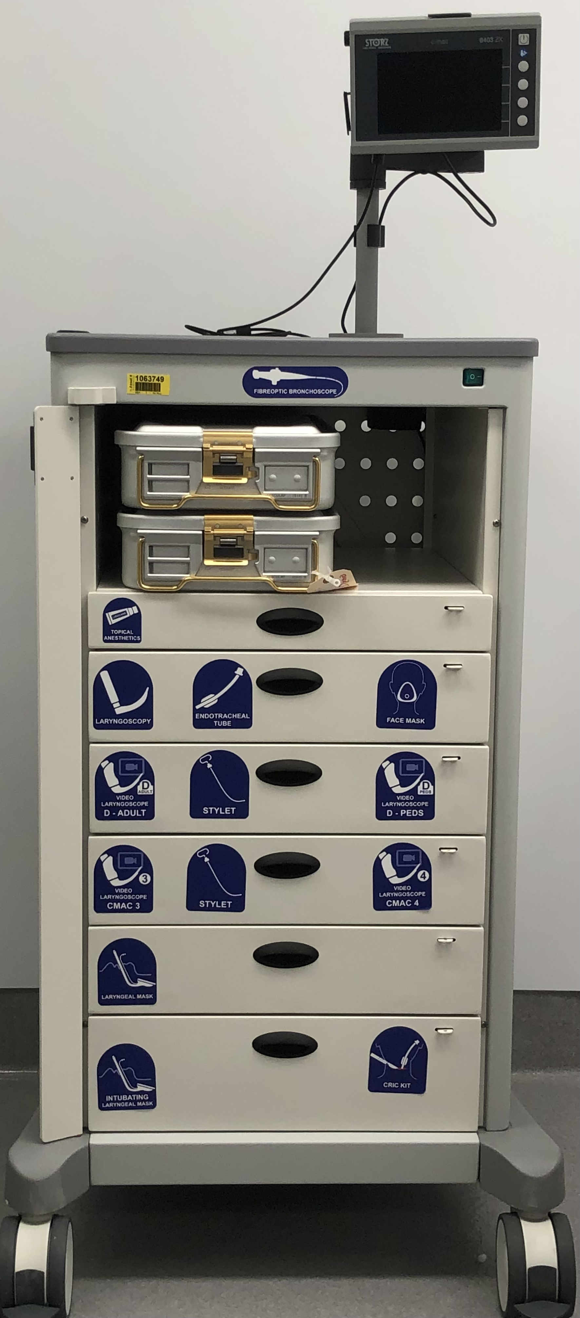
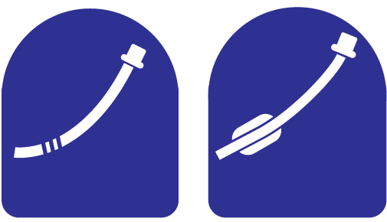
Designing and implementing a new visual-based difficult airway cart: a multi-pronged approach
Zasso FB, Lokon A, Nabecker S, Colvin C, Venn S, You-Ten E, Siddiqui N
Introduction
Results
The difficult airway cart is no longer seen just as a place to store assorted airway equipment.
Other aspects such as design, organization, and labelling are being more carefully considered to facilitate effective clinical care. ¹
Airway guidelines and societies advocate for certain features of the difficult airway cart with the intention of improving human factors, such as design.²⁻⁴
1st drawer – Topical Anesthetics Tongue depressor Mucosal Atomizer Device Lidocaine 4% solution Lidocaine 5% ointment Lidocaine 2% gel Lidocaine 10mg Spray Antifog Epidural catheter Ovassapian Airway Swivel Connector
2nd drawer – Laryngoscope/endotracheal tube/Face mask Laryngoscope Armoured tube 6 Macintosh blade ¾ Face mask Miller Blade 3 Reusable face masks S/M/L Short handle Disposable face masks M/L Bougie Oral airway S/M/L 2 Regular stylets Nasal airway 6/7/8 Endotracheal tube Endotracheal Tubes 6/7/8 Micro laryngoscopy Tubes 4/5 Mcgill forceps
3rd drawer – Video laryngoscopes D-Blades 1 C-MAC Adult D-Blade 1 C-MAC Peds D-Blade 2 C-MAC stylets
4rd drawer - Video laryngoscopes Regular Blades 1 C-MAC Regular Blade 3 1 C-MAC Regular Blade 4 2 C-MAC stylets
5th drawer – Laryngeal masks Classic LMA 3/4/5 Supreme LMA 3/4/5
6th drawer – Intubating laryngeal masks/Cric kit Fastrach LMA 3/4/5 Fastrach ETT 6/7/8 Cric Kit
Question (n=30) | Y
New airway carts icons are self-explanatory? | 100%
New airway carts is organized for emergency? | 100%
Icons are helpful to find equipment? | 97%
Question (n=15 - Nurses) | Pre | Post
Fiberoptic Bronchoscope | 40%
Cricothyroidotomy kit | 40%
Comfortable to assist (mean NRS) | 6.2 | 7.9
Methods
Start point → developing icons for the new difficult airway cart drawers.
Iterative design process consisting of rounds of end-user feedback.
The content of the cart was discussed in the Anesthesia Department in two sessions.
Implementation sessions were performed independently with each group of end-user. A pre and post-session questionnaire was applied
Conclusion
The difficult airway cart with an intuitive structured layout assists in finding what is needed in a stressful crisis scenario.⁵
The visual display of icons may avoid harmful delays and help anesthetists overcome mental hurdles.⁶
Icons
Recognized
Not recognized
References
1- Chrimes N, Bradley WPL, Gatward JJ, Weatherall AD. Human factors and the 'next generation' airway trolley. Anaesthesia. 2019 Apr;74(4):427-433.
2- Chishti K. Difficult Airway Society: Setting up a Difficult Airway Trolley (DAT). Assessed on https://das.uk.com/content/difficult_airway_trolley.
3- Law J, et al. Canadian Airway Focus Group updated consensus-based recommendations for management of the difficult airway: part 1. Difficult airway management encountered in an unconscious patient. CJA 2021; 68(9):1373-1404.
4- Apfelbaum J, et al. 2022 American Society of Anesthesiologists Practice Guidelines for Management of the Difficult Airway. Anesthesiology 2022; 136(1):31-81.
5- Bjurström MF, Bodelsson M, Sturesson LW. The Difficult Airway Trolley: A Narrative Review and Practical Guide. Anesthesiol Res Pract. 2019 Jan 27;2019:6780254.
6- Cook TM, Woodall N, Frerk C; Fourth National Audit Project. Major complications of airway management in the UK: results of the Fourth National Audit Project of the Royal College of Anaesthetists and the Difficult Airway Society. Part 1: anaesthesia. Br J Anaesth. 2011;106:617-631.
Consensus

Slide 5
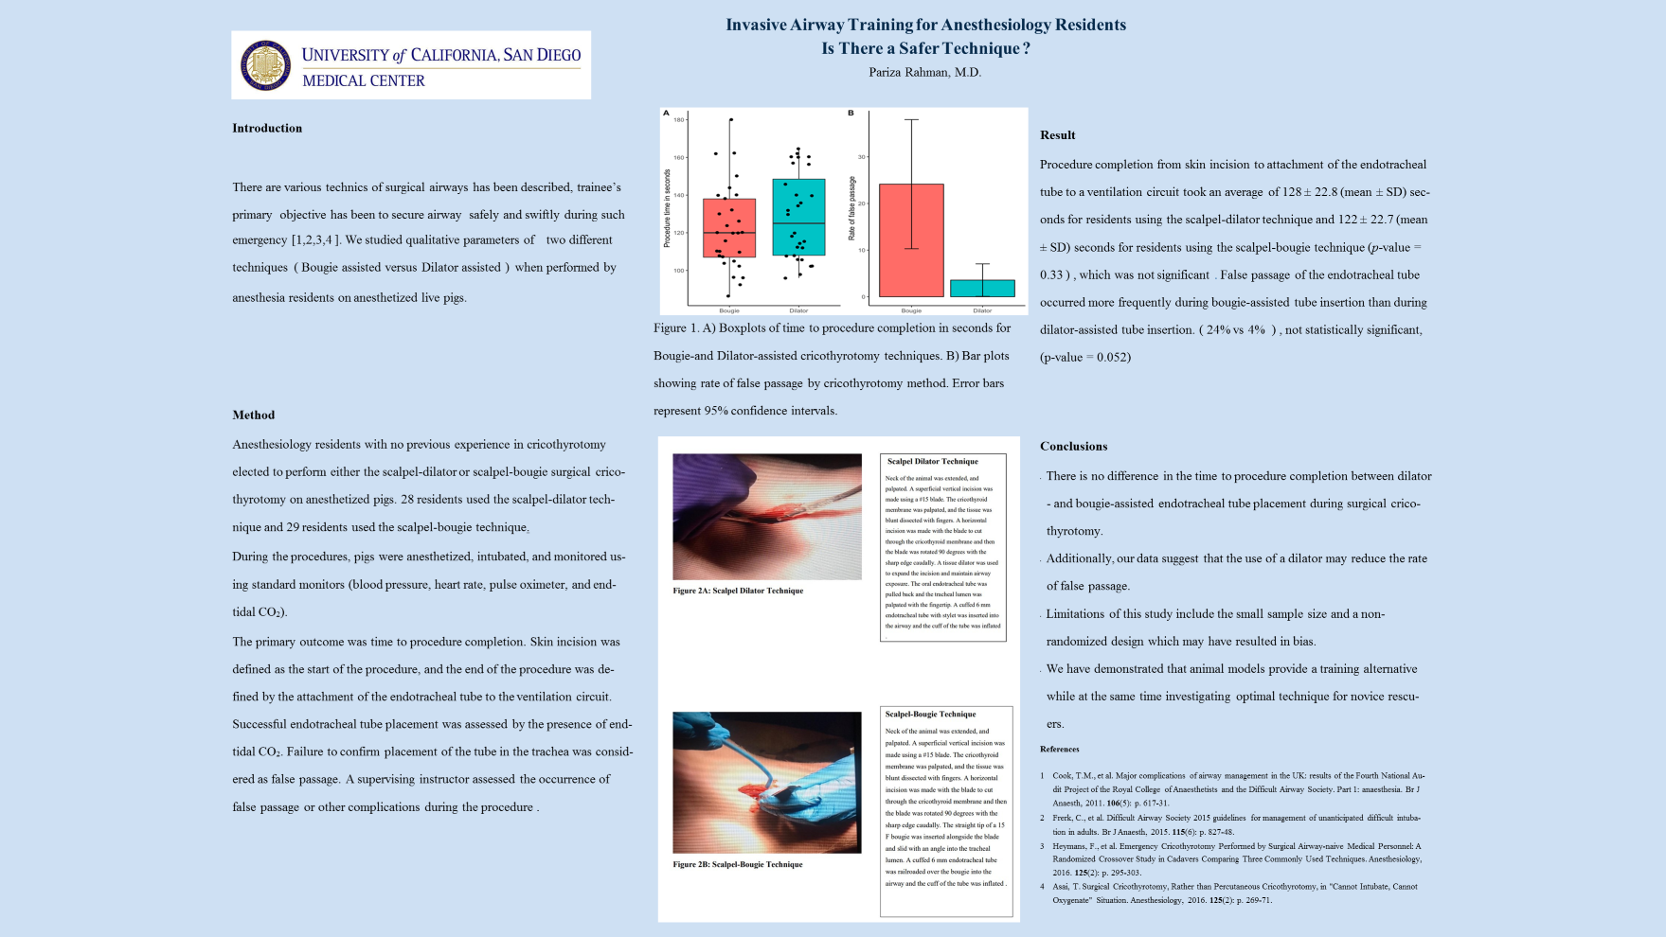

Slide 6
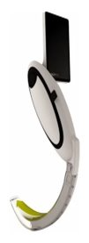
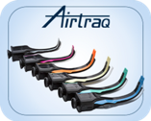
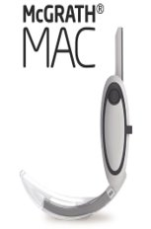
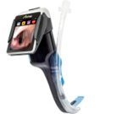
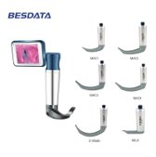

Slide 7
channeled or non-channeled VL, which is more popular? Our recent experience
Until July, the only option provided by the hospital was a channeled VL. The sudden availability of non-channeled VL posed a scenario in which we could study the preference of anesthesiologists given a free choice of models.
We registered 17 uses of non-channeled VL versus 5 uses of channeled VL in July and August.
We explain the preference for non-channeled over channeled due to: 1 - the use resembles DL, and may be even an ameliorated DL with better magnification, illumination and smarter blade design whenever a Mac blade is used; 2 - need of assembling (camera and screen) with the channeled device, although it could be used just with the eyepiece (only one use without a screen); 3 - the much more straightforward possibility of use of bougie with non-channeled VL.

