Slide 1
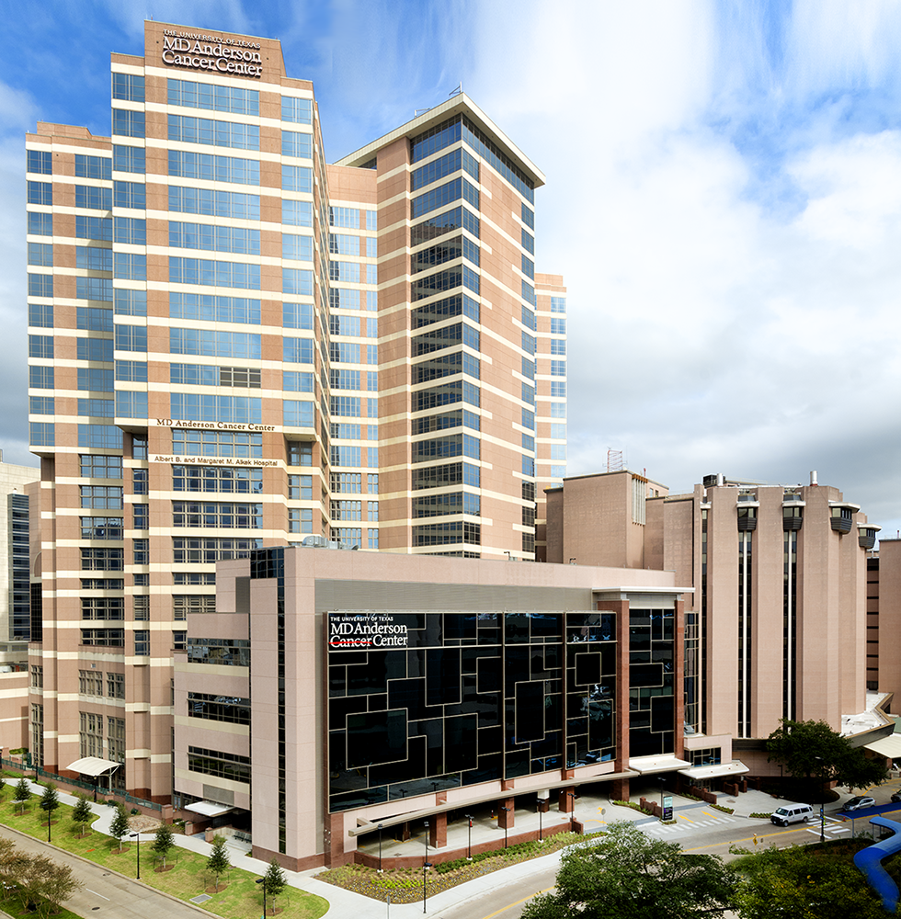

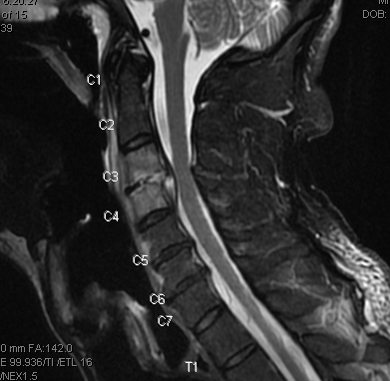
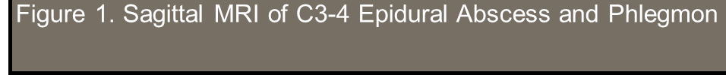
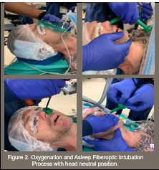

Head neutral Fiberoptic Intubation to Prevent Cord Compression in a Patient with a Cervical Spine Epidural Abscess
Muthukumar A, Bui T, Williams C, Roland G, Shrestha L, Zavala A, Kwater P, Huffard E, Tsai J
The University of Texas MD Anderson Cancer Center
Introduction
Intubating a patient with a cervical epidural abscess requires special attention to prevent compression of the cervical spinal cord and inadvertent abscess rupture. Some studies have shown that symptoms are out of proportion to the actual compression of the cord and nerve roots (1). Options for minimizing compression of the abscess and cord in elective and emergent situations include cervical spine stabilization done manually or with a cervical collar, [2] fiberoptic intubation with neutral head positioning, and awake intubation. We present an atraumatic asleep fiberoptic intubation with neutral head positioning in an anxious patient.
Case Presentation
We administered propofol, fentanyl, and rocuronium and then placed a lengthwise split nasal trumpet in the left nostril. After confirming mask ventilation, we introduced the flexible fiberoptic scope through the trumpet, performed gentle jaw thrust, and visualized the vocal cords. Once the Fiberoptic scope approached the carina, the nasal trumpet was removed. A 6.5 mm reinforced ETT was passed over the scope (figure 2). At the end of surgery, a deep extubation was performed, the patient had a normal neurological exam, and no complications were noted.
Discussion
Asleep fiberoptic intubation with a spotter is a safe and feasible method to secure the airway and prevent cervical spine manipulation and the risk of consequent neurologic injury (3). The closed epidural compartment narrows from the cervical to lumbar regions. Cervical collars as well as manual in-line stabilization (MILS) have produced cervical spine flexion varying from 10 to 22.9 degrees and caused dural sac compression.[4] Fiberoptic intubation with MILS has demonstrated segmental motion from C0 through C6 of 5 to 19 degrees.[5] Videolaryngoscopy and fiberoptic intubation with MILS have documented high failure rates at 30 seconds. As in our case, neutral head positioning with minimal jaw thrust has shown to cause less motion derangements than chin lift in patients with an unstable cervical spine (6).
Case Presentation
A 43 year old man with a history of stage IV non-small cell lung cancer with diffuse bony metastasis complicated by bacteremia, candidemia, and infectious spondylodiscitis at C3-C4 presented for dental extractions. MRI showed an epidural abscess with paraspinal and foraminal involvement (figure 1). A drain was deemed not feasible, and he was not a neurosurgical candidate. Antibiotics were started. On physical exam, the patient had severe cervical spine pain and restricted cervical range of motion. In the operating room, the patient positioned himself to comfort with a neutral head position prior to induction. We preoxygenated the patient prior to induction, and neck position was monitored throughout by a spotter
.
References

Slide 3


Slide 5
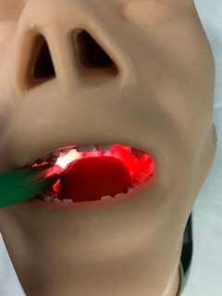
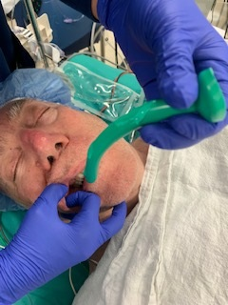
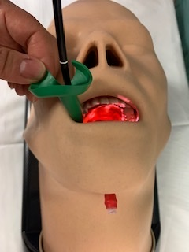
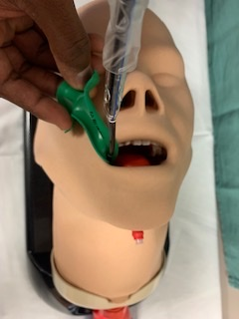
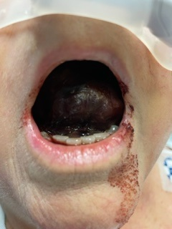
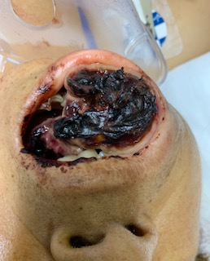
The use of a nasal trumpet for oral retromolar intubations
Williams CW, Su J, Sharma I, Zavala A, Singh Heir J, Truong A and D Truong
The University of Texas MD Anderson Cancer Center
Introduction
Securing the airway for surgical procedures can be difficult if the patient has trismus or has an oral mass. Novel approaches have been described to aid in difficult airway intubations, one of these being the retromolar technique. The retromolar space, as described in D Truong et al, is located in the posterior portion of the mouth behind the last molar and anterior to the ramus of the mandible (1). In this method, various sizes of nasopharyngeal trumpets are placed in the retromolar space to evaluate its size and create a memory pathway. After the nasal trumpet is removed, a flexible scope is placed in the retromolar space and the endotracheal tube is passed through the cords (2). We describe a novel technique where the nasal trumpet is cut longitudinally and left in place for the guidance of the flexible scope.
Case 1
.
Discussion
There are many advantages to utilizing this technique. In patients with trismus or a large oral mass which prevent the use of direct laryngoscopy, this maneuver bypasses the need for a good incisor distance. Direct laryngoscopy in a patient with trismus or large oral mass could result in bleeding, lip and tongue trauma, or tooth chipping. The main advantages are that it prevents secretions and or blood from collecting on the flexible scope. It is also easily accessible and cost effective. Disadvantages include knowing how far to place the nasal trumpet and a second person should be present to hold the nasal trumpet in place. The flexible scope can also come out of the longitudinal cut before entering the retromolar space.
.
A 78 year old man with a history of pseudomyxoma peritonei presented for an excision of intrabdominal tumors. The patient complained of jaw pain with prior anesthetics and preferred not to have mouth opened wide. The decision was made to use this technique where minimal mouth opening was required. The patient was easily intubated using this technique and in follow up phone calls the patient stated that he did not have any jaw pain after this technique.
Technique
Intubation through the retromolar space using the nasal trumpet was completed using the following steps. Cut nasal trumpet cross- section longitudinally. Obtain a flexible scope and insert an endotracheal tube around the scope. Insert nasal trumpet in retromolar space to provide a pathway for the flexible scope. An inch or two of the tube should be visible outside of the mouth to ensure the nasal trumpet is not inserted too deep. (Figure 1A & 1B). Once the nasal trumpet is inserted, place the flexible scope inside of the opening of the nasal trumpet. (Figure 1B). When you are able to see the carina via the flexible scope, remove the nasal trumpet. (Figure 1C). Begin sliding the endotracheal tube down the flexible scope until trip of tube is placed at the carina. Remove flexible scope and inflate balloon on endotracheal tube to complete intubation.
Case 2 and 3
The images below are of patients with oral masses emergently intubated in the ICU at night using this technique.
.
.
References
Truong A, Ahmad B, Cata J, Martin J, Truong DT, and TF Rahlfs. Measurement of retromolar space dimensions using dental pantomograms for intubation feasibility. Head and Neck volume 38, issue S1, p. E638-E642.
Truong A and DT Truong. Retromolar flexible fiber-optic orotracheal intubation: A novel alternative to nasal intubation and tracheostomy in severe trismus. Head and Neck Volume 37, issue 3, p 423-424.

