Slide 1
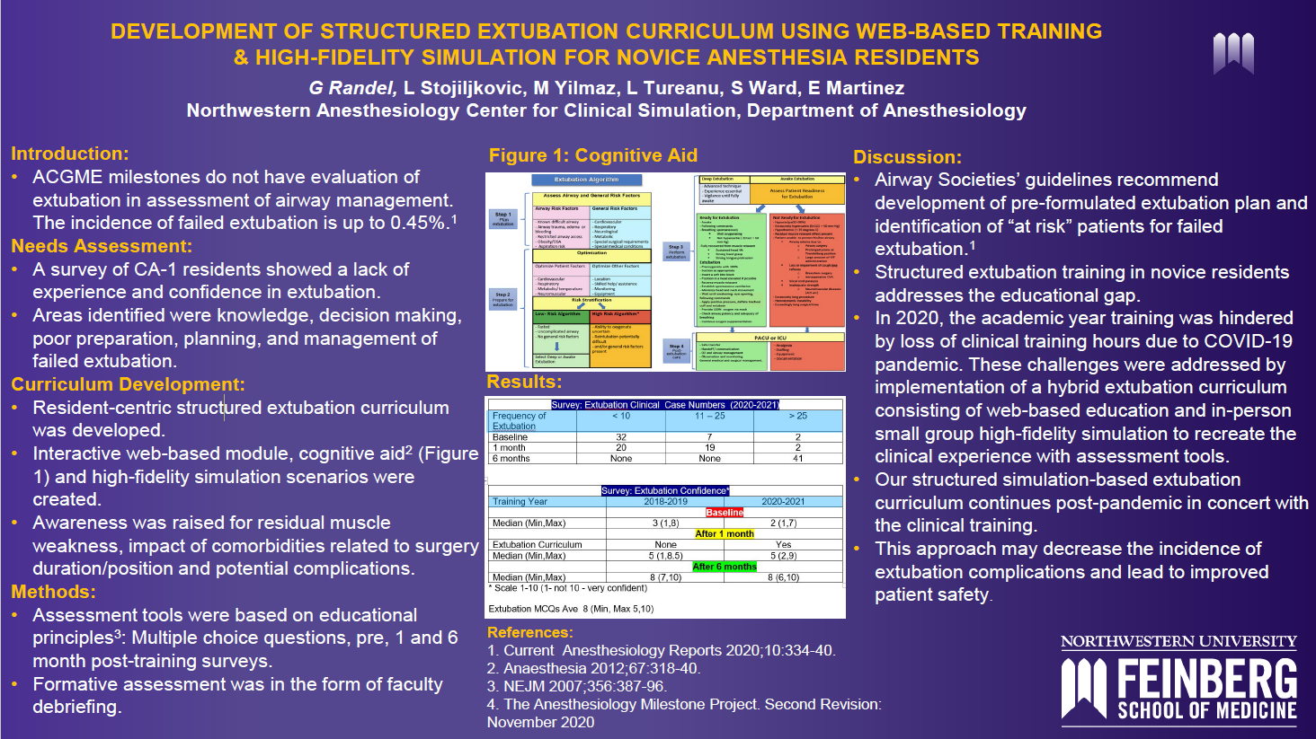

Slide 2


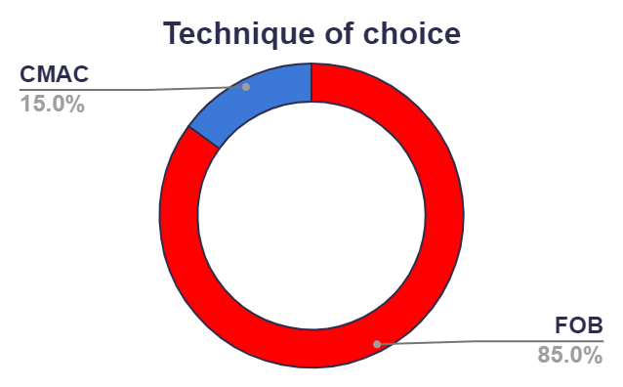
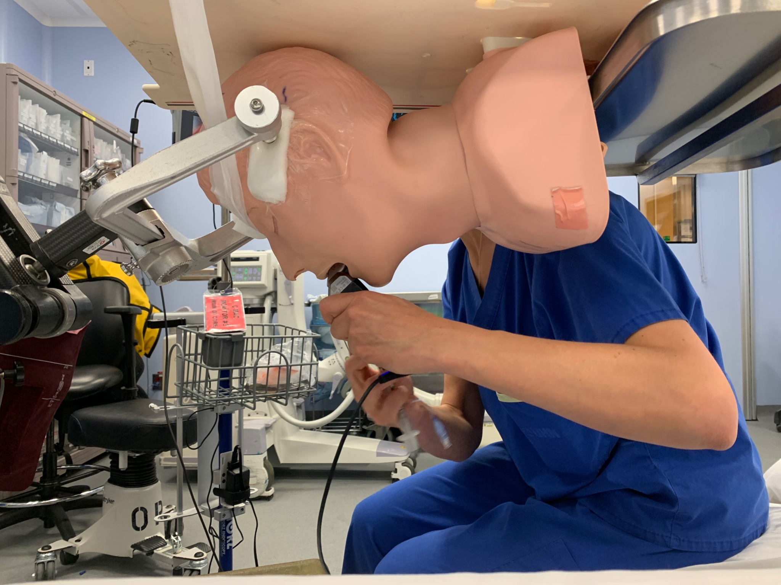
Emergency airway management in the prone position: An observational mannequin study
Wesley Rajaleelan MBBS MD, Eugene Tuyishime MD,
Zoe Unger MD FRCPC , Lakshmikumar Venkataraghavan MD FRCA FRCPC, Michael Dinsmore MD PhD FRCPC
Toronto Western Hospital and University of Toronto, Toronto, Ontario, CANADA
Introduction
Results
The inclusion of participants’ position, prior experience of handling an inadvertent prone extubation, or number of years of experience as covariates in the model did not affect results
Fellows, compared to staff were faster in establishing a definitive airway using a CMAC and slower using a FOB, but they failed more times than the staff anesthesiologists.
Amongst the 7 participants who failed to establish a definitive airway in the allotted time of 180 seconds 3 participants had a prior experience of establishing an airway in real life during an inadvertent extubation during prone positioning
Accidental extubation during prone position can be a life-threatening emergency requiring rapid establishment of airway¹⁻³. However, there is limited evidence of the best airway rescue method for this potentially catastrophic emergency. The aim of this study was to determine the most effective method to recover the airway in case of an inadvertent extubation during prone positioning by comparing three techniques: the supraglottic airway, video laryngoscope, and fibre optic bronchoscopy.
Success rates of airway rescue were LMA = 100%, CMAC = 69.6% and FOB = 91.3%
The mean (SD) time to secure the airway was LMA = 18.1 (4.8) secs , CMAC = 78.3 (32.0) secs and FOB = 57.3 (24.6) secs.
Five (23.8%) participants (2 staff and 3 fellows) had a prior experience of handling an inadvertent prone extubation in their career.
The mean experience of the participants in anaesthesiology as a specialty was 12.0 (5.8) years.
RIB
PLEURA
LUN
Material and Methods
Thy
This is an observational mannequin study comparing the airway rescue performances of three techniques: the supraglottic airway (LMA), video laryngoscope (CMAC), and fibre optic bronchoscope (FOB).
Total of 23 participants : Anesthesia Staff = 11 (47.8%) and Fellows = 12 (52.1%) performed airway management on a mannequin positioned prone in head pins.
The time required for definitive airway management and the success rates were recorded.
TP
Conclusions
Cephalad
The results of this mannequin study suggest that the supraglottic airway had the highest success rate in re-establishing the airway in the prone position. For intubation, the FOB was more successful than the CMAC.
References
1. Abrishami A, Zilberman P, Chung F. Brief review: Airway rescue with insertion of laryngeal mask airway devices with patients in the prone position. Canadian Journal of Anaesthesiology. 2010; 57:1014–20.
2. Thiel D, Houten J, Wecksell M. Accidental tracheal extubation of a patient in the prone position. AA Case Reports. 2014; 2:20–2.
3. Hung MH, Fan SZ, Lin CP, Hsu YC, Shih PY, Lee TS. Emergency airway management with fiberoptic intubation in the prone position with a fixed flexed neck. Anesthesia & Analgesia. 2008; 107:1704–6.
There were significant differences in the time required for definitive airway management between the LMA and FOB (t = 5.79, p<0.001, 95% CI = 25.92 – 52.38), the LMA and CMAC (t = 8.90, p<0.001, 95% CI = 46.93 – 73.40), and the FOB and CMAC (t = 3.11, p=0.003, 95% CI = 7.78 – 34.25)
Figure 1 - Mannequin fixed onto the OR table in a prone position with Mayfield pins mimicking position for posterior fossa surgery / cervical spine surgery

Slide 3

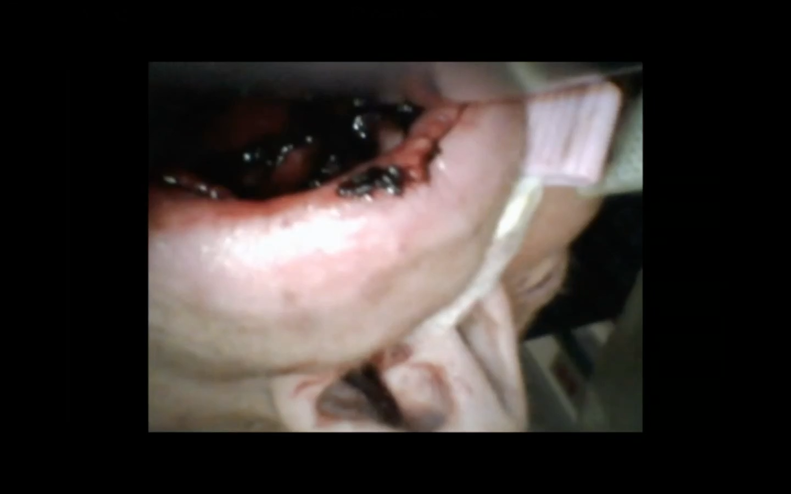

Eat Your S.A.L.A.D. With A Bougie: A Case Report of A Challenging Airway in the ICU
Background:
Airway management in the ICU is challenging. Studies have demonstrated the negative consequences of failure to intubate an ICU patient in one attempt. One study identified blood in the airway as a factor associated with decreased first attempt intubation success. Techniques such as suction-assisted laryngoscopy and airway decontamination (S.A.L.A.D.) have been described as a strategy to improve first attempt success in the bloody airway but may have limited applicability. This is a case report of an unanticipated bloody airway managed in one attempt with a bougie. The bougie has a role in difficult airway management in the ICU for improving first pass success, but the benefits in the bloody airway are not known.
Case Presentation:
The patient is a middle-aged female with cancer on chemotherapy who presented with encephalopathy, sepsis, respiratory failure and renal failure. She had been previously intubated and extubated to NIMV. Her encephalopathy and hypoxemia were worse despite NIMV and she required reintubation.
References:
Discussion:
The bougie was used successfully as part of a bundle of skills to manage the unanticipated bloody airway. This approach avoided complications associated with prolonged apnea time and multiple attempts. Bougie use allowed tactile feedback of placement in the trachea to serve as a method of confirmation of appropriate tube placement when visibility was limited by the blood.
Author:
Caleb Taylor MD MPH
Pulmonary Critical Care Medicine Fellow
Media:

Slide 4


Slide 5
Eat Your S.A.L.A.D. With A Bougie: A Case Report of A Challenging Airway in the ICU
Background:
Airway management in the ICU is challenging. Studies have demonstrated the negative consequences of failure to intubate an ICU patient in one attempt. One study identified blood in the airway as a factor associated with decreased first attempt intubation success. Techniques such as suction-assisted laryngoscopy and airway decontamination (S.A.L.A.D.) have been described as a strategy to improve first attempt success in the bloody airway but may have limited applicability. This is a case report of an unanticipated bloody airway managed in one attempt with a bougie. The bougie has a role in difficult airway management in the ICU for improving first pass success, but the benefits in the bloody airway are not known.
Case Presentation:
The patient is a middle-aged female with cancer on chemotherapy who presented with encephalopathy, sepsis, respiratory failure and renal failure. She had been previously intubated and extubated to NIMV. Her encephalopathy and hypoxemia were worse despite NIMV and she required reintubation.
References:
Discussion:
The bougie was used successfully as part of a bundle of skills to manage the unanticipated bloody airway. This approach avoided complications associated with prolonged apnea time and multiple attempts. Bougie use allowed tactile feedback of placement in the trachea to serve as a method of confirmation of appropriate tube placement when visibility was limited by the blood.
Author:
Caleb Taylor MD MPH
Pulmonary Critical Care Medicine Fellow
Media:

