Slide 1


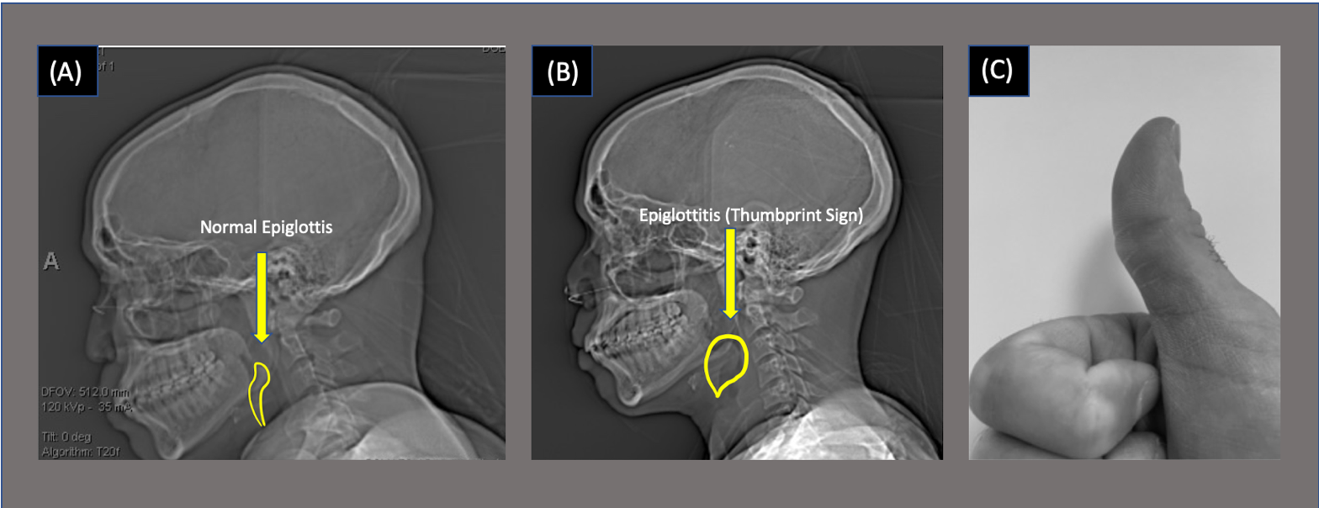
Epiglottitis Presentation in an Adult Patient with Acute Myeloid Leukemia
Idowu T, Strang A, Williams C, Donahue H, Kwater AP, and Dang A
The University of Texas MD Anderson Cancer Center
CASE
A 34-year-old man with recurrent acute myeloid leukemia status post-chemotherapy presented with gastrointestinal and oral graft-versus-host disease. He was diagnosed with epiglottitis, necessitating elective, asleep video-assisted intubation using a C-MAC #3 (Karl Storz, Tuttlingen, Germany) video laryngoscope, bougie, and a reinforced 6.0 mm endotracheal tube. Successful intubation required multiple attempts due to loose friable tissue and copious secretions that limited visibility of the glottic opening.
INTRODUCTION
There are less than twenty documented cases in the literature of acute epiglottitis in patients undergoing cytotoxic chemotherapy. These patients develop infection from organisms not classically associated with epiglottitis.¹ The overall clinical presentation is similar to that of immunocompetent patients.² There should be a low threshold for suspecting epiglottitis in neutropenic patients who develop drooling, stridor, and odynophagia.³
We report a case of epiglottitis in a 34-year-old man with a history of acute myeloid leukemia who presented with the classic “thumbprint” sign on lateral CT in the setting of epiglottitis.
DISCUSSION
The “thumbprint sign” on lateral neck radiograph is indicative of a thickened epiglottis.³ Early recognition and intervention through rapid airway assessment and subsequent management is essential. Compared to direct laryngoscopy, flexible intubating endoscopy and video laryngoscopy have a lower risk of airway collapse.²
One study found that less than 1% of adult patients presenting to the emergency center with acute epiglottitis underwent laryngoscopy or other airway procedures.⁴ This suggests that clinicians may be relatively uniformed about the proper clinical interventions for these patients and the urgency with which airway interventions need to be initiated.⁵
REFERENCES
1. Lee AC, Lam SY. Life threatening acute epiglottitis in acute leukemia. Leuk Lymphoma. 2002;43(3):665-667. doi:10.1080/10428190290012254
2. Bridwell RE, Koyfman A, Long B. High risk and low prevalence diseases: Adult epiglottitis. Am J Emerg Med. 2022;57:14-20. doi:10.1016/j.ajem.2022.04.018
3. Chen C, Natarajan M, Bianchi D, Aue G, Powers JH. Acute Epiglottitis in the Immunocompromised Host: Case Report and Review of the Literature. Open Forum Infect Dis. 2018;5(3):ofy038. Published 2018 Feb 17. doi:10.1093/ofid/ofy038
4. Hanna J, Brauer PR, Berson E, Mehra S. Adult epiglottitis: Trends and predictors of mortality in over 30 thousand cases from 2007 to 2014. Laryngoscope. 2019;129(5):1107-1112. doi:10.1002/lary.27741
5. Ames, W. A., Ward, V. M., Tranter, R. M., & Street, M. (2000). Adult epiglottitis: an under-recognized, life-threatening condition. British journal of anaesthesia, 85(5), 795–797. https://doi.org/10.1093/bja/85.5.795
Figure 1: CT scan of a normal epiglottis (A), CT scan of a patient infected with epiglottitis (B), and a thumb for illustration of the “thumbprint sign” (C) human thumb

Slide 2


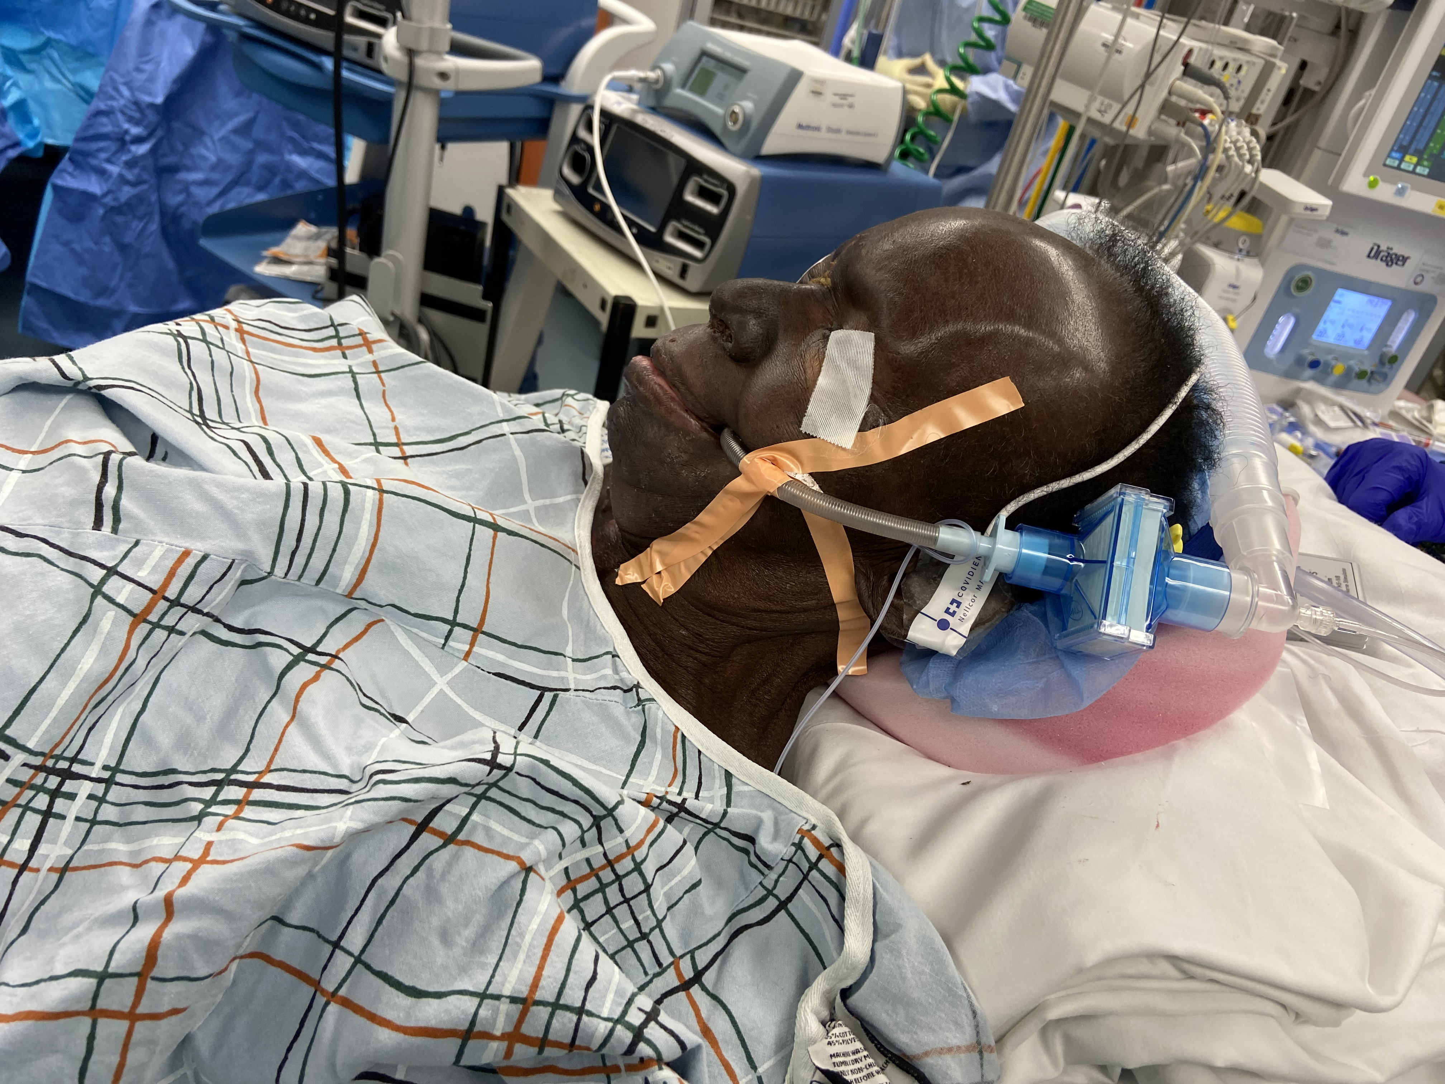
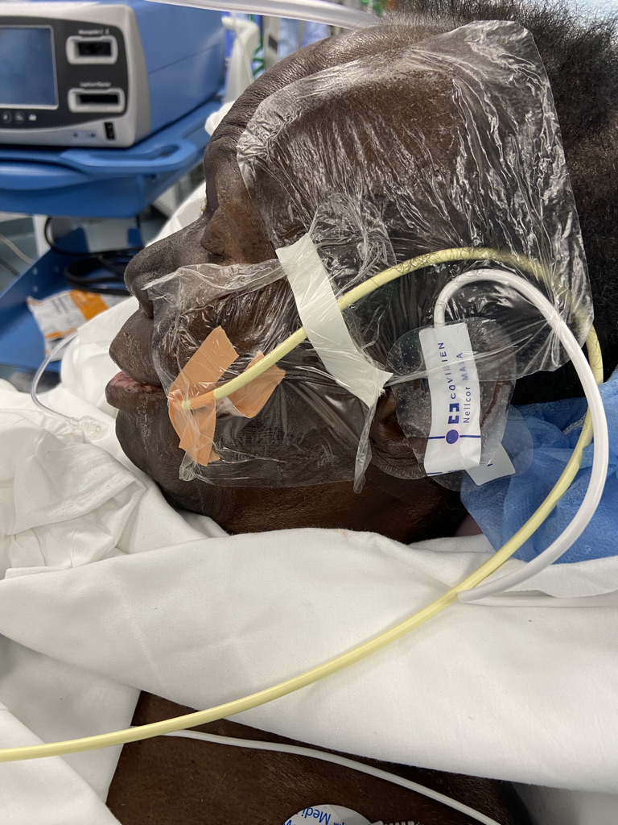
Awake Fiberoptic Intubation in Patient with
Extensive Maxillary Adenocarcinoma: A Case Report
VanderVeen M MD, Narang J MBBS, MD
Dept. of Anesthesiology
Background
Patients with head/ neck cancer often present with difficult airways. Induction of GA in these patients can worsen the airway obstruction and lead to respiratory compromise. Awake FOB is essential in managing this population to maintain spontaneous ventilation
Intraop Course:
Fiberoptic scope was advanced until adequate visualization of the vocal cords. A 6.0 reinforced ETT was railroaded easily and GA was induced with etomidate and rocuronium
Extubation
At the end of the case, patient was extubated over a 11F Cook Exchange Catheter (removed after 2 hours).
Follow up surgery:
Pt. came back to OR 4 months later after neoadjuvant chemoradiation and then for resection of residual tumor with a flap. Maxillary cancer had shrunk. Nasal awake FOB was done successfully with HFNC
Case Presentation:
73 year old F with R maxillary adenocarcinoma scheduled for G- tube placement prior to chemoradiation. Patient had a 10 cm necrotic mass in the R hard palate with narrowing of the nasopharynx and oropharynx. PE: Patient was in severe pain, drooling and orthopneic at rest, SaO₂ 91%. Airway Exam:, 2 FB mouth opening, noncompliant submandibular region, radiation burns on the neck, limited tongue protrusion coated with secretions, and Mallampatti 4
Discussion:
A thorough history and PE is crucial in determining the presence of a difficult airway and need for an awake intubation. Furthermore, there should be a multi-disciplinary approach involving the anesthesia, ENT, and surgical teams. We had huddle in preop and then preop period. If all failed ENT team was to perform a tracheostomy.
Intraop Course:
Preoxygenated with HFNC (THRIVE) at 60L/min. Sedation with remifentanil was started at 0.05 mcg/kg/min. The oropharynx was topicalized with viscous lidocaine & 4% lidocaine was then sprayed with atomizer.
References:
Ahmed-Nusrath Anaesthesia for head and neck cancer surgery, BJA Education, Volume 17, Issue 12, December 2017, Pages 383–9

Slide 4
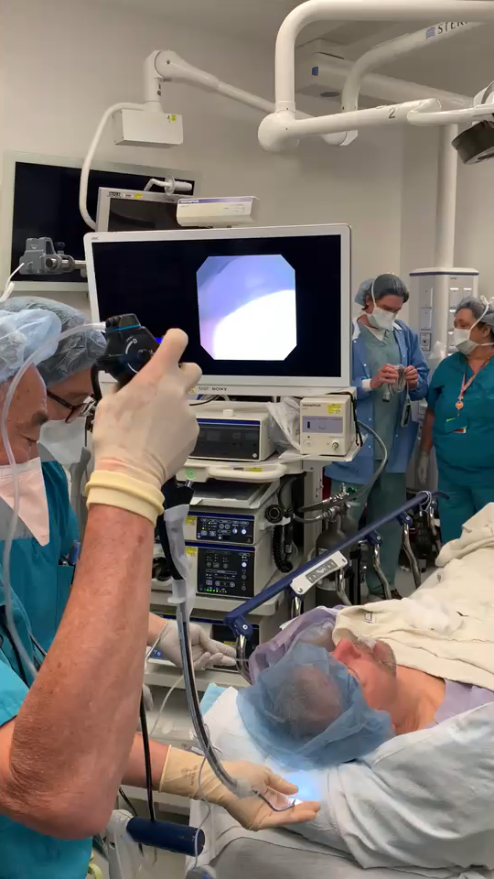

Slide 6
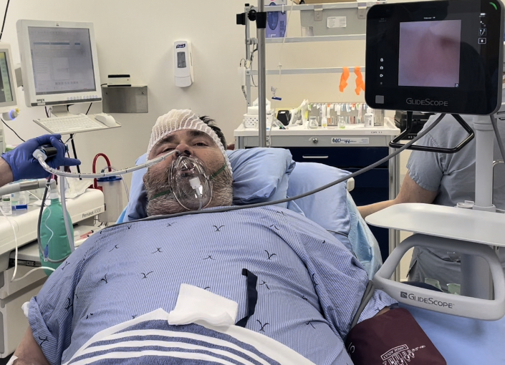
Failed awake bronchoscopic intubation in an opioid-resistant patient in OR. A case report.
Telgarsky B
Staff Anesthesiologist and Intensivist
The Moncton Hospital
Moncton NB Canada
Background: Awake bronchoscopic intubation used in an anticipated difficult airway may fail in 1-2%.¹⁻⁴ This case report reinforces the need to have a back-up plan for an awake intubation, particularly in patients on novel drugs.
Case Presentation: A 44 year, BMI 55, mouth opening of 1 cm due to an extensive right dental abscess, listed for incision and drainage. On Naltrexone 50 mg PO daily for alcohol use disorder. Remifentanil infusion and Fentanyl boluses failed to provide any sedation. Despite adequate topicalisation, antisialogogue administration, and Midazolam, Dexmedetomidine and Propofol sedation, multiple attempts at bronchoscopic intubation failed due to inadequate cough suppression, with copious amounts of pus suctioned from mouth. With a mouth opening improved to 2 cm, general anesthesia was induced with a successful intubation using a GlideScope.
Discussion: Implications of this case are twofold. First, it reports an opioid resistance in a patient taking Naltrexone, making sedation and cough suppression, when using opioids, ineffective. ⁵⁻⁶ Second, it highlights the need to have a rescue plan for any airway technique, and reports a successful exit strategy in failed awake intubation in line with the latest guidelines.⁴
References:
1. El-Boghdadly K, Onwochei DN, Cuddihy J, et al. A prospective cohort study of awake fibreoptic intubation practice at a tertiary centre. Anaesthesia 2017; 72: 694– 703.
2. Law JA, Morris IR, Brousseau PA, de la Ronde S, Milne AD. The incidence, success rate, and complications of awake tracheal intubation in 1,554 patients over 12 years: an historical cohort study. Canadian Journal of Anesthesia 2015; 62: 736– 44.
3. Joseph TT, Gal JS, DeMaria SJ, Lin H-M, Levine AI, Hyman JB. A retrospective study of success, failure, and time needed to perform awake intubation. Anesthesiology 2016;125: 105–14.
4. Ahmad I, El-Boghdadly K, Bhagrath R, Hodzovic I, McNarry AF, Mir F, O'Sullivan EP, Patel A, Stacey M, Vaughan D. Difficult Airway Society guidelines for awake tracheal intubation (ATI) in adults. Anaesthesia 2020;75(4): 509-528.
5. Reus VI, Fochtmann LJ, Bukstein O, et al. The American Psychiatric Association practice guideline for the pharmacological treatment of patients with alcohol use disorder. Am J Psychiatry 2018;175(1): 86-90.
6. Vickers A P, Jolly A. Naltrexone and problems in pain management. BMJ 2006; 332 :132.

