Slide 2


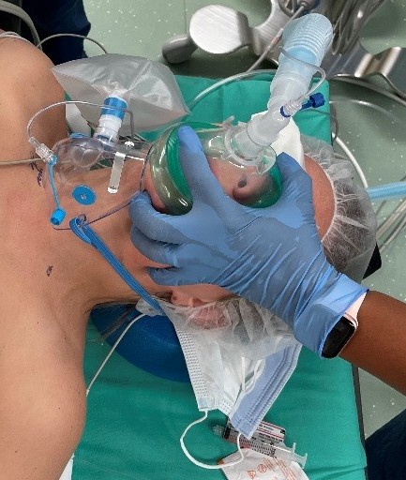
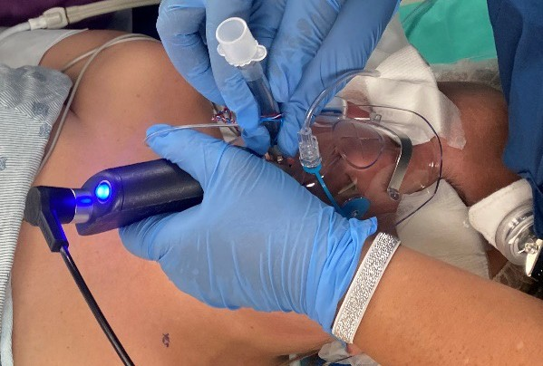
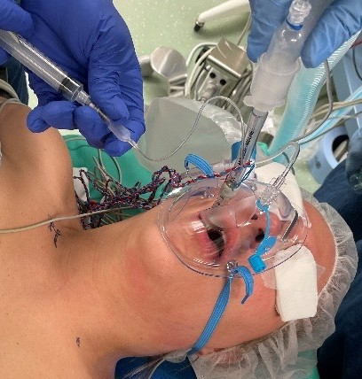
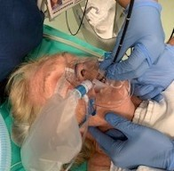
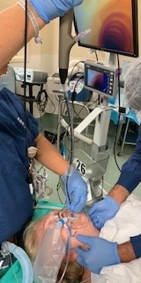
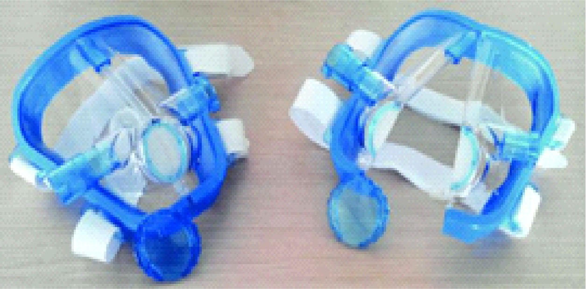
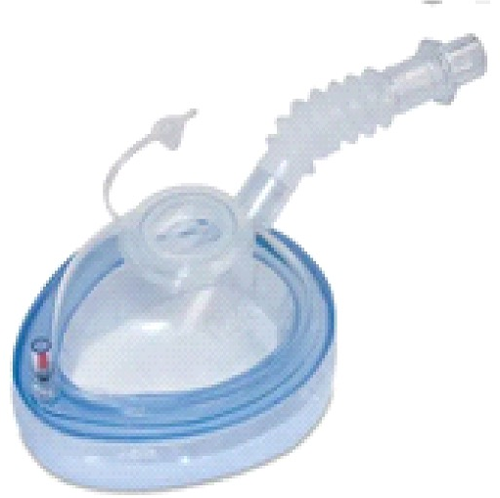
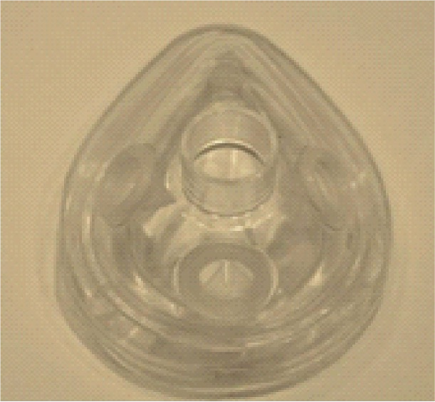
Multiple techniques to access the airway through a Procedural Oxygen Mask (POM)
Roland G, Kapoor A, Zavala A, Muthukumar A, Kwater P, Owusu-Agyemang P, Hurst D, Idowu T, and Porche V The University of Texas MD Anderson Cancer Center
Introduction
The Procedural Oxygen Mask (POM) is a Food and Drug Administration-approved mask that is currently used for endoscopy and transesophageal echocardiograms (TEE). The mask has a unique self-sealing ability with built-in ports for endoscopic insertion at the oral and nasal orifices. [1] The design of the mask is important, especially in the age of the coronavirus pandemic and monkeypox spread because it limits the opportunity for viral exposure or contamination in the OR. The potential of the mask can be appreciated beyond its simplistic design as it also provides versatility and multifactorial benefits. We present a case series using the oral port for intubation.
Case Report 1
A 37 yo female presented for a unilateral complete thyroid lobectomy and level II-IV neck dissection. The patient was pre-oxygenated with a POM mask, and after induction masked with a regular mask. For the intubation, the POM mask had been cut at the end of the longer port to make the opening longer, and it was again placed over the face. A CMAC-3 was placed through the oral port and a size 7 NIMS tube was placed thought the oral port into the airway. The procedure had no complications.
Discussion
There is minimal literature on the use of the POM mask during intubation. The successful use of the POM mask can provide a safer method of airway access and increased oxygenation in a time when the patient is not breathing. Additionally, with the rise of COVID variants and Monkeypox cases, anesthesia teams are at risk of exposure during these aerosol generating procedures.
Through the utilization of the POM mask, we can
decrease the risk of spreading airborne viruses and other pathogens. The POM is a useful tool in multiple airway access procedures such as intubation via endotracheal tube, and fiberoptic intubation which makes it a great candidate for future utilization in a variety of cases. Other advantages include, but are not limited to, the POM’s ability to preserve FiO2. A study showed that with an oxygen reservoir bag, the POM was able to deliver 0.88 to 0.95 FiO2 compared to the
0.40 to 0.60 and 0.30 to 0.45 FiO2 provided by the
traditional oxygen mask and nasal cannula respectively.
[1] Overall, the ability of the POM to provide airway access in a diverse set of procedures while also
decreasing anesthesiologists' exposure to potentially infectious respiratory droplets and aerosolized clouds
(cough) is sufficient evidence to consider increase usage in future cases. Additionally, the POMs
concomitant provision of increased oxygenation and
ability to transport to and in the PACU are additional affirmation to investigate its usage in the future.
Case Report 2
75 year-old woman with a history of malignant melanoma presented for excision. She was induced, an Ovassapian was placed, a POM mask was placed on her face, and a flexible scope intubation was performed without complications.
References
1. Go⭲zalcz RM. Maximizi⭲g Paťic⭲ť a⭲d Sťarr SarcťQ K"íi⭲g ľía⭲scsopkagcal EckocaídiogíapkQ i⭲ ťkc COVIK-19 Eía bQ Usc or a Ncw OxQgc⭲ Kcli:cíQ SQsťcm: E⭲doscopQ OxQgc⭲ Masks wiťk Sclr-Scali⭲g E⭲doscopc I⭲scíťio⭲ Poíťs. J Am Soc Eckocaídiogí. 2021 Apí;«4(4):45«-454. doi: 10.1016/j.ccko.2020.12.022. Ep"b
2020 Kcc «1. PMIK: «««®®446; PMCIK: PMC7774456.
Further research can also be done for the use of other endoscopic masks with ports for airway access including the Janus single port mask [2], the VBM single-port mask, and the multi-port explorer endoscopic mask [3].
VBM mask, below
2. Cabíi⭲i Ḻ a⭲d G Ḻa⭲do⭲i. A No:cl ⭲o⭲-⭲:asi:c :c⭲ťilaťio⭲ mask ťo píc:c⭲ť a⭲d ma⭲agc ícspiíaťoíQ rail"íc d"íi⭲g ribcíopťic bío⭲ckoscopQ, gaťíoscopQ a⭲d ťía⭲scsopkagcal cckocaídiogíapQ. Hcaíť, l"⭲g a⭲d :csscls. 2015; 7(4):297-«0«.
«. Poťié A, Píégaídic⭲ C, Piíoťťc ľ, Sťcpkc⭲⭲c X, Sckccís I, Wa⭲ťQ C, Smcťs I, Sokal E, a⭲d Iía⭲cis VcQckcma⭲s. E:al"aťio⭲ or ťkc Exploící E⭲doscopQ Mask© roí csogasťíod"odc⭲oscopQ i⭲
ckildíc⭲: a ícťíospccťi:c sť"dQ or 17« cascs. Pcdiaťíic A⭲csťkcsia 25 Apíil 2016 kťťps://doi.oíg/10.1111/pa⭲.12910Ja⭲"s rig"íc: kťťps://www.ícscaíckgaťc.⭲cť/rig"íc/ľkc-Ja⭲"s-Mask-dc:icc- closcd-roí-"sc-lcrť-a⭲d-opc⭲-roí-posiťio⭲i⭲g- íigkť_rig1_««6257®11VBM a⭲d POM imagc: kťťps://bcllmcdical.com/
Janus mask, above
Explorer Mask, above

