Slide 1


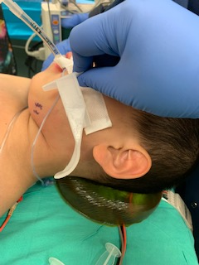
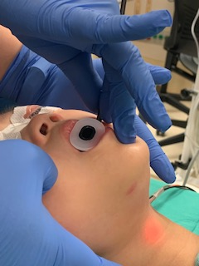
Dedicated adjuncts are needed for pediatric
flexible video endoscope intubations
Jones WS, Sharma I, Idowu T, Kwater A,Owusu-Agyemang P, Zavala A, Bankston CB, Sansguiri A, Lau B and R Arunkumar
Introduction
Known difficult airways in the pediatric population often necessitate the usage of a flexible video endoscope (FVE). The use of these FVEs is often in conjunction with a variety of adjuncts to help move the tongue anteriorly to maintain adequate room in the oral cavity for fiberoptic scope maneuvering and endotracheal tube (ETT) insertion. However, all available adjuncts on the market are aimed at the adult population and are too large to be used for pediatric patients. It is well established that pediatric patients have low functional residual capacity and cannot tolerate longer periods of apnea during intubation, even with adequate pre-oxygenation. Thus, first try endotracheal intubation is particularly important in this patient population. Below, we present a case report of a difficult airway in which first-try endotracheal intubation was challenging due to the non-production of properly sized flexible scope intubating adjuncts.
A
B
the oral cavity that could decrease visibility from the flexible scope. This is of special note in our pediatric cancer population, as these patients often have a chemotherapy induced thrombocytopenia and propensity for bleeding with
even minor injury, and any unnecessary trauma to the mouth and oropharynx should be avoided at all costs.
Also, in one study comparing modified Guedel airways to laryngeal mask airways (LMA) in their use as adjuncts for fiberoptic intubation in infants and children, it was shown that using a modified Guedel airway led to significantly less first attempt success when compared to laryngeal mask airway (20% vs 73.33%). Although use of an LMA as an intubating aid is a useful tool for difficult airways, careful consideration must be paid as an LMA lumen longer than the length of the ETT can lead to further difficulties in securing the airway. It is also necessary to remove the circuit adapter from the ETT before introducing the ETT on to the fiberoptic scope and through the LMA, or the LMA would not be able to be removed over the ETT once the airway is secured. Additionally, the mouth opening must be large enough to allow placement of an LMA in order to use it as an intubating adjunct. We therefore recommend the development of an Ovassapian-like device in an array of pediatric sizes.
Figure 1: (Image A) Ovassapian shown next to pediatric patient for size reference. (Image B) Guedel oral airway in place with fiberoptic scope inserted to the left of the oral airway.
Case Report
A five-year-old with a past medical history of recurrent sialoblastoma status-post two prior resections for the same diagnosis presented for port placement for chemotherapy needs. Due to prior oral surgeries and recurrent oral pathology, the patient was a known difficult airway. Considering this known difficult airway, we elected to perform an asleep flexible videoscope intubation. Initially, an Ovassapian airway was attempted, but was found to be too large (as demonstrated by image A, taken post-intubation). A Guedel oral airway was then placed to aid in moving the tongue more anteriorly. However, this also came with the disadvantage of requiring the fiberoptic scope to be inserted into the oral cavity from the side of the mouth, and not midline (as demonstrated in image B).
Discussion
Currently, there are three commonly available intubating oral airways: the Ovassapian, the Williams, and the Berman. It is important to note there is also the Berman oral airway, which does not have a conduit for a fiberoptic scope. Lastly, the Guedel oral airway is also widely used, but its hollow core does not have a large enough diameter to accommodate a fiberoptic scope. It is important to note that none of the above three adjuncts to aid in the placement of an ETT under flexible scope guidance are available in pediatric sizes. Modified Guedel oral airways have been used before, but they are non-standardized, not readily available, and could have sharp edges once modified for flexible scope intubation. Of course, any sharp objects should be avoided from being placed in the oral cavity as the mucosa can be sensitive to abrasions and tears, leading to bloody secretions in
References
Rastogi, A., Jain, A., Singh, S., & Gyanesh, P. (2012). Modified Guedel's airway for facilitation of fiberoptic laryngoscopy. Journal of Anaesthesiology Clinical Pharmacology, 28(4), 542. Retrieved 3 16, 2022, from https://ncbi.nlm.nih.gov/pubmed/23225953
Varghese, E., Nagaraj, R., & Shwethapriya, R. (2013). Comparison of oral fiberoptic intubation via a modified Guedel airway or a laryngeal mask airway in infants and children. Journal of Anaesthesiology Clinical Pharmacology, Vol 29, Issue 1.

Slide 2
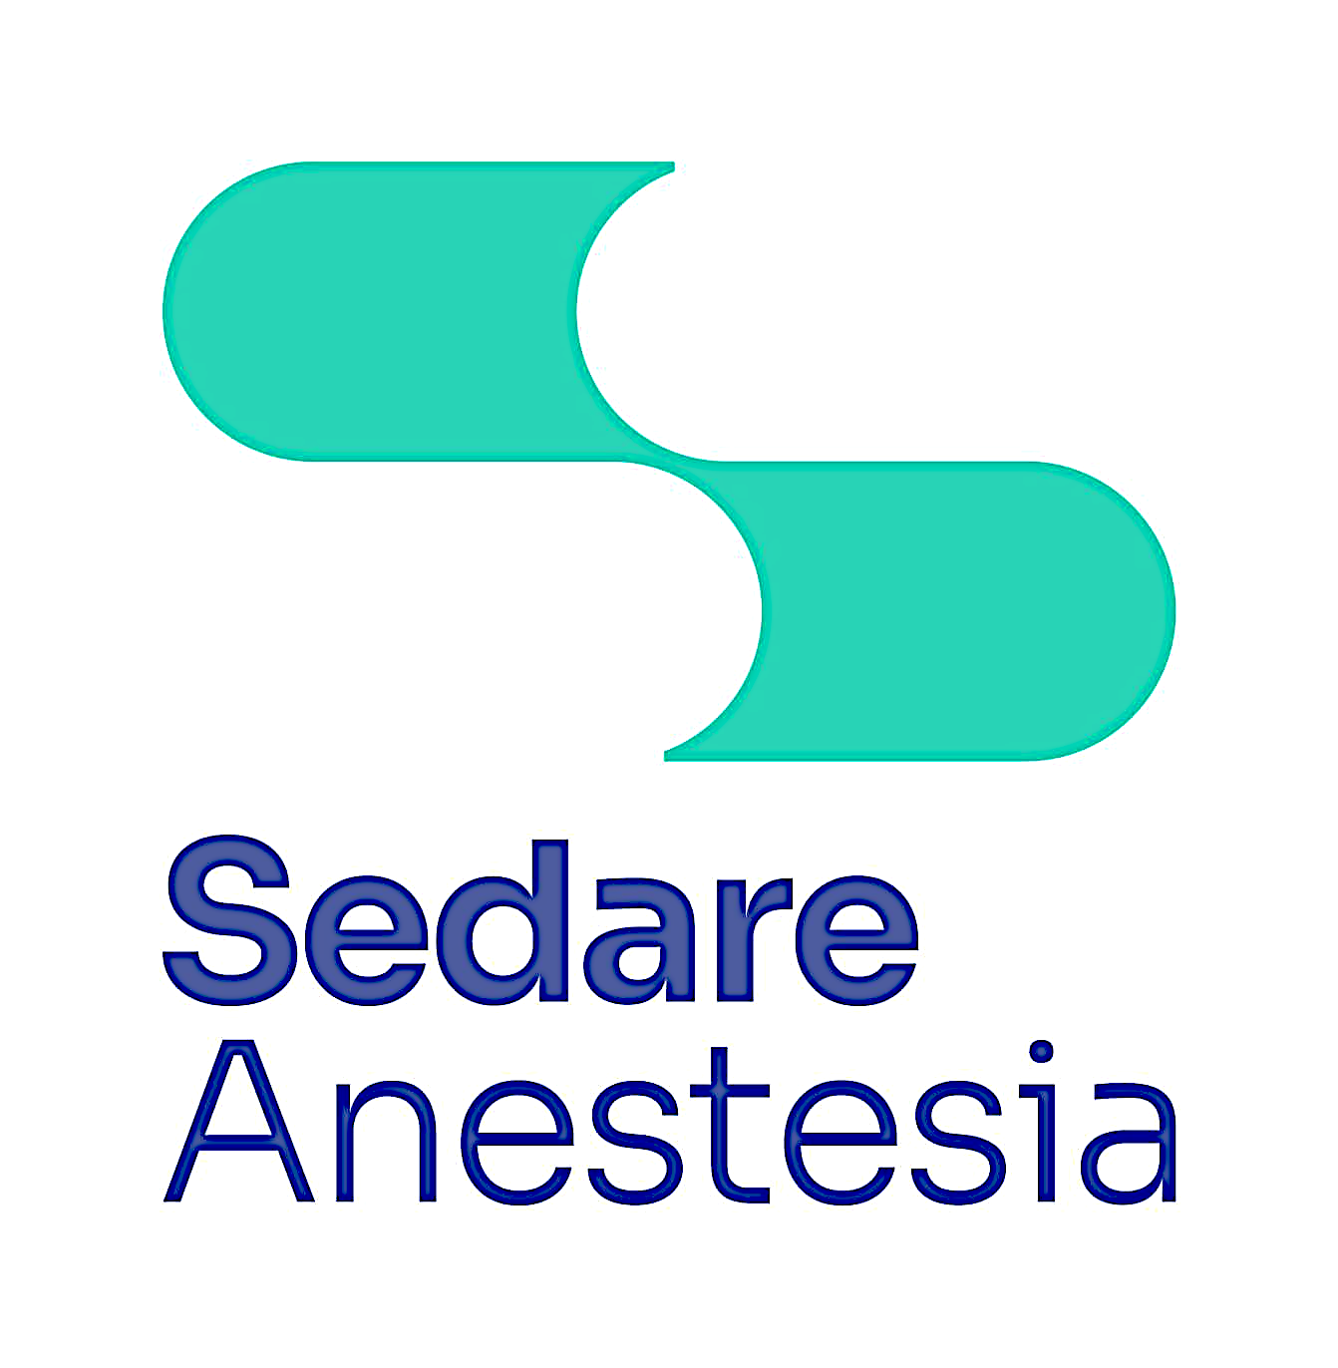

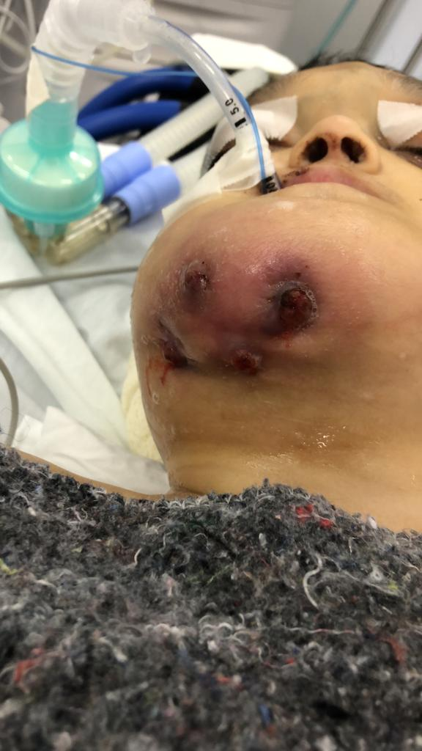
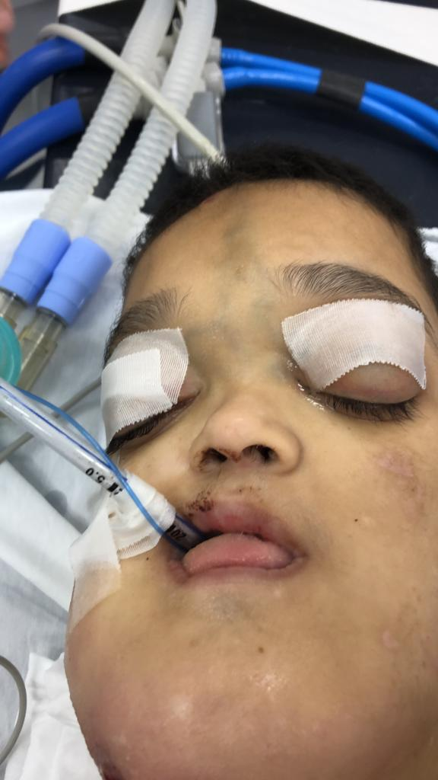
Case Report: Non collaborative Crouzon syndrome patient with a submandibular abscess: difficult airway management strategy
Authors:
Prado R, Muniz LA, Malito LM; Perin D, Ramos MS, Amaral Neto, M.
Background: Crouzon syndrome is a rare disease. A preanesthetic evaluation and airway management strategy is mandatory. The premature fusion of the base of the skull, face hypoplasia, prognathism, arch palate and occasional upper airway obstruction can lead to difficult intubation and mask ventilation.
Case Presentation: 13yrs old male patient with Crouzon Syndrome was submitted for a submandibular abscess drainage. He had a previous history of difficult airway management, OSA, facial distortion and the submandibular abscess. Fully awake intubation wasn’t possible because of the lack of patient’s collaboration. The cricothyroid membrane was identified with USG. After obtaining 22G i.v. line, 0,5 mcg/kg dexmedetomidine was infused in 10 minutes. A Pacey’s paste was distributed in the oral cavity. The patient was preoxygenated and induction was made titrating sevofluorane. A jaw thrust was made maintaining the airway opened and the oxygen/sevoflurane was delivered via a nasal catheter during the FOI uneventfully. The patient was extubated fully awake with good respiratory drive.
Discussion:
This rare syndrome normally causes anxiety for the airway management by the anesthesiologist. It is very important to define the strategy according to the environment conditions and expertise of the doctor attending the case. It is crucial to understand the disease and know how to deal with possible fails during the intubation process. This case showed a successfully way to deal with a submandibular abscess in a difficult airway management patient.
References:
Venkat Raman V, de Beer D. Perioperative airway complications in infants and children with Crouzon and Pfeiffer syndromes: A single-center experience. Paediatr Anaesth. 2021 Dec;31(12):1316-1324. doi: 10.1111/pan.14310. Epub 2021 Oct 21. PMID: 34623012.
Pellerin P, Vinchon M, Guerreschi P, Anastassov Y, Zhang ZY, Tang XJ, Alonso N. Crouzon Syndrome Anatomy, Usefulness of Vestibular Orientation. J Craniofac Surg. 2022 Mar 14. doi: 10.1097/SCS.0000000000008644. Epub ahead of print. PMID: 35288499.

Slide 3

Case Report: Hypertensive Pneumothorax using Jet Ventilation in a post-covid patient during a traqueal dilation.
Authors:
Prado R, Muniz LA, Malito LM; Perin D, Ramos MS, Amaral Neto, M.
Background: Traqueal dilation is always a challenging case because of the shared airway and the grade of the stenosis.
Case Presentation: 58yrs, male patient, BMI:32,4, ASA P2 with important traqueal stenosis after 43 days of tracheostomy because of a COVID19 infection and stridors. The patient was preoxygenated and induced intravenously with sufentanil (30ug), lidocaine(100mg) and rocuronium(15mg). DL was performed (C&L 2A) and a Frova catheter was introduced and MANUJET ventilation was started (4psi, RR 10).. Just after the beginning of the dilation, the patient became plethoric, drop of SpO₂, ST segment elevation and thorax asymmetry in the left side. The hypertensive pneumothorax was treated with a 20G punction follow by drainage and patient stabilization. The dilation was done maintaining jet ventilation for 25 minutes. The patient was extubated fully awake.
Discussion:
The ventilation through a Frova catheter allows good conditions for the surgeon to dilate patient with tracheal stenosis. Complications are dangerous and the team must be aware to diagnose and solve them quickly.
References:
Macedo Neto AV, Oliveira HG, Macedo BR et al. Tratamento endoscópico das estenoses funcionais das vias aéreas. Disponível em www.sopterj.com.br/wp-content/themes/_sopterj_redesign_2017/_revista/2011/n_02/03.pdf
Bapat S, Bidaye R, Gandhi S (2018) Use of the Frova® Intubating Introducer for Interval Ventilation and Debulking with Laser in a Difficult Airway. JSM Head Face Med 3(1): 1010.

Slide 4

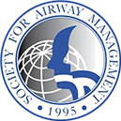

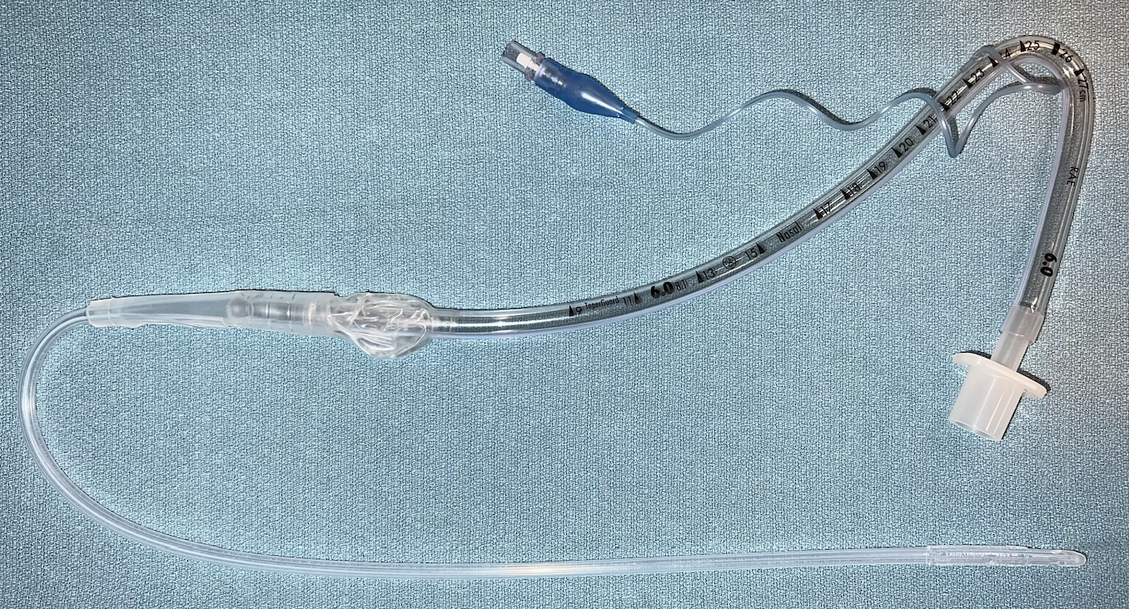
A randomized controlled study to determine the effects of urinary
catheter-assisted nasal intubation on nasal bleeding in adult patients
Lokon A, Jervis L, Lee M, Wild E, Siddiqui N, You-Ten E, Zasso FB
Introduction
Primary aim: To assess the incidence and severity of epistaxis after urinary catheter-assisted nasal intubation compared to control (standard nasal intubation).
Secondary aims: To assess the time to successful intubation and the number of attempts at nasotracheal tube insertion.
Epistaxis is a frequent complication of nasal intubation despite topical vasoconstriction and thermo-softening of the endotracheal tube (ETT).¹⁻³
Flexible urinary catheter-assisted nasal intubation has been suggested to aid atraumatic insertion of the ETT.^{4,5}
Results
76 patients were included in the analysis – 4 exclusions due to failure to collect pharyngeal swabs.
No differences in baseline characteristics (age, gender, prior nasal surgery), size of ETT inserted, or experience of airway operator between groups.
Urinary catheter-assisted nasal intubation was associated with a statistically significant reduction in the incidence of epistaxis, severity of epistaxis, and number of attempts (Table 1).
No difference in time to successful insertion of nasal ETT with urinary catheter-assisted nasal intubation vs control (Table 1).
Methods
Conclusions
Single-centre, patient and assessor-blinded RCT.
80-patients having elective surgery requiring nasal intubation were recruited.
Randomised by sealed envelope to urinary catheter-assisted nasal intubation or control group (standard nasal intubation).
Both groups received xylometazoline (0.1%) and thermo-softening of the ETT.
Intervention group had a urinary catheter telescoped onto the tip of the ETT to guide insertion. The catheter was retrieved from the mouth using Magill forceps prior to intubating the glottis.
After nasotracheal intubation, a posterior pharyngeal swab was taken in a standardized manner using gauze.
Blinded assessors then graded bleeding severity on a four-point visual-analogue scale: Nil, mild (1-24%), moderate (25-49%), or severe (≥50%) gauze saturation.
Urinary catheter-assisted nasotracheal intubation:
  Reduces the rate of clinically significant epistaxis when compared to standard nasal intubation.
  Reduces the number of attempts to achieve successful nasotracheal intubation.
  Does not increase the time required for intubation.
Table 1. Summary of significant findings
 | Control group (n=37) | Catheter-assisted group (n=39) | P-value
Any epistaxis - Relative risk | 28 (75.7%) | 19 (48.7%) 0.64 [95% CI 0.44-0.93] | P = 0.02
Severe epistaxis - Relative risk | 6 (16.2%) | 0 (0.0%) 0.22 [95% CI 0.07 – 0.71] | P = 0.01
>1 attempt for successful insertion | 12 (32.4%) | 2 (5.1%) | P = 0.02
Time to successful intubation (seconds) | 102.8 (73.8) | 93.8 (30.5) | P = 0.24
References
Lu PP, Liu HP, Shyr MH, et al. Softened endotracheal tube reduces the incidence and severity of epistaxis following nasotracheal intubation. Acta Anaesthesiol Sin. 1998;36(4):193-7.
Kim YC, Lee SH, Noh GJ, et al. Thermosoftening treatment of the nasotracheal tube before intubation can reduce epistaxis and nasal damage. Anesth Analg. 2000;91(3):698-701.
Katz RI, Hovagim AR, Finkelstein HS, et al. A comparison of cocaine, lidocaine with epinephrine, and oxymetazoline for prevention of epistaxis on nasotracheal intubation. J Clin Anesth. 1990;2(1):16-20.
Watt S, Pickhardt D, Lerman J, et al. Telescoping tracheal tubes into catheters minimizes epistaxis during nasotracheal intubation in children. Anesthesiology. 2007;106(2):238-42.
Elwood T, Stillions DM, Woo DW, et al. Nasotracheal intubation: a randomized trial of two methods. Anesthesiology. 2002;96(1):51-3.
Values expressed as number per group (percentage) or mean (S.D). P <0.05 accepted as significant

