Slide 1


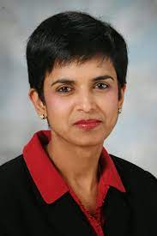
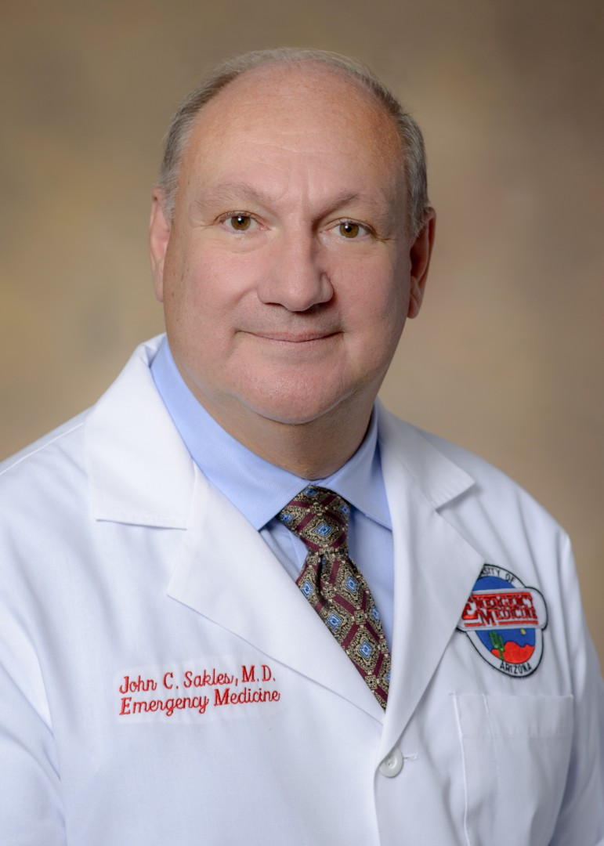

23rd Annual
15th - 18th, 2022
John C. Sakles, M.D.
Program Chair
REGISTER NOW!!!
Radha Arunkumar, M.D.
Program Co-Chair
www.samhq.com
The 23rd Annual Society for Airway Management Scientific Meeting & Workshop
will be held at the JW Marriott Starr Pass Resort & Spa, September 15-18, 2022

Slide 2
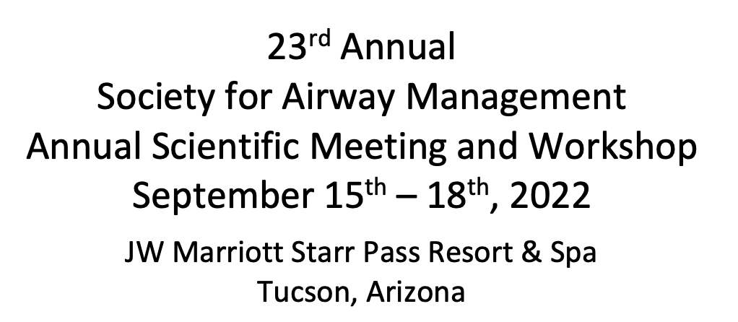


CALL FOR ABSTRACTS!!!
Be part of one of the most rewarding sessions of the annual meeting.
Submit your abstract for consideration as a poster presentation.
The top 3 abstracts will be eligible for oral presentation!!!
Final submission deadline will be Friday, August 5th, 2022, by Midnight EST.

Slide 3
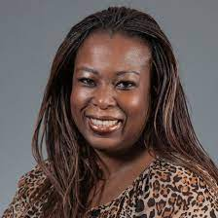
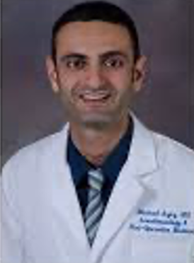
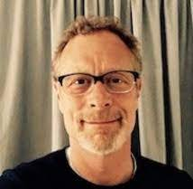

TRACEY STRAKER, M.D.
MODERATOR
PRO/CON DEBATE
THE PHYSIOLOGICALLY DIFFICULT AIRWAY
MIKE AZIZ, M.D.
GEORGE KOVACS, M.D.
RAPID
SEQUENCE
INTUBATION
AWAKE
TRACHEAL
INTUBATION

Slide 4
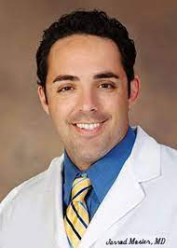
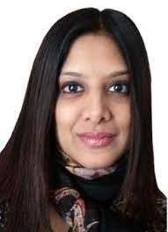
TRACEY STRAKER, M.D.
MODERATOR
PRO/CON DEBATE
THE HYPOXEMIC COVID PATIENT
JARROD MOSIER, M.D.
SHEILA MYATRA, M.D.
EARLY
INTUBATION
LATE
INTUBATION

Slide 5
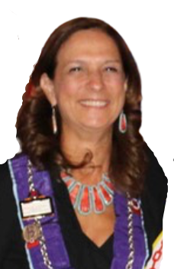
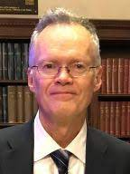

TRACEY STRAKER, M.D.
MODERATOR
PRO/CON DEBATE
NON-OR ANESTHESIA IN THE MORBIDLY OBESE
TO INTUBATE OR NOT?
THAT IS THE QUESTION!
JON SAMUELS, M.D.
LORRAINE FOLEY, M.D.
PRO
INTUBATION
PRO
NON-INVASIVE

Slide 6
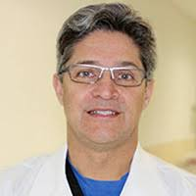
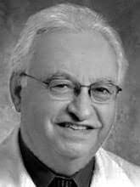
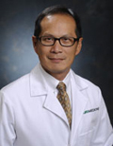
FELIPE URDANETA, M.D.
MODERATOR
OVASSAPIAN HONORARY LECTURE
AIRWAY MANAGEMENT IN CARDIAC ARREST:
BMV vs. SGA vs. ETT
Andranik Ovassapian
In Memoriam
HENRY WANG, M.D.
University of Texas
Houston, Texas

Slide 7
EXPERT’S ROUND TABLE DISCUSSION– Session I
BEST APPROACHES FOR AWAKE INTUBATION
PREHOSPITAL AIRWAY CHALLENGES
OXYGENATION METHODS DURING TRACHEAL INTUBATION
MAKE
YOUR
CHOICE!
ULTRASOUND FOR AIRWAY ASSESSMENT & MANAGEMENT
AIRWAY CRISIS MANAGEMENT USING A TEAM AND
HUMAN FACTORS APPROACH
FRONT OF NECK ACCESS (FONA)
ANZCA CICO PART 1
TRACHEAL EXTUBATION MANAGEMENT: CHALLENGES & SOLUTIONS
AIRWAY MANAGEMENT IN THE CRITICALLY ILL
PROJECT FOR UNIVERSAL MANAGEMENT OF AIRWAYS (PUMA)

Slide 8
EXPERT’S ROUND TABLE DISCUSSION-Session II
ADVANCED AIRWAY MANAGEMENT WITH SUPRAGLOTTIC AIRWAYS
AIRWAY MANAGEMENT STRATEGIES FOR THE COMPLEX
HEAD AND NECK PATIENT
HOW TO ESTABLISH DIFFICULT AIRWAY RESPONSE TEAM – (DART) AT YOUR INSTITUTION
MAKE
YOUR
CHOICE!
ULTRASOUND FOR AIRWAY ASSESSMENT IN ADULTS & CHILDREN
AIRWAY TEAMS AND POLICIES TO IMPROVE PATIENT OUTCOME
AIRWAY MANAGEMENT IN THE OBSTETRIC PATIENT
HOW TO ORGANIZE A FORMAL AIRWAY ROTATION AND OPTIMIZE AIRWAY EDUCATION IN YOUR DEPARTMENT
PEDIATRIC AIRWAY MANAGEMENT:
NEW EQUIPMENT AND
NEW TECHNIQUES
FRONT OF NECK ACCESS (FONA)
ANZCA CICO PART 2

Slide 9
IMPROVE YOUR SKILLS!
HANDS-ON WORKSHOPS
SURGICAL
AIRWAY
ULTRASOUND OF THE AIRWAY
FIBEROPTICS/
VIDEOLARINGOSCOPY/SGA/NON-INVASIVE RESPIRATORY SUPPORT
AIRWAY EXCHANGE CATHETERS/
DOUBLE LUMEN TUBES
AIRWAY
MANAGEMENT
WORKSHOP
SALAD AIRWAY DECONTAMINATION
PEDIATRIC AIRWAY STATION
DIFFICULT AIRWAY ALGORITHM/ RESCUE CRICOTHYROTOMY
CLINICAL AIRWAY SIMULATION

Slide 10
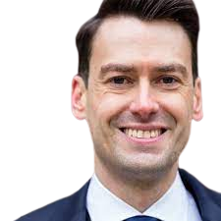
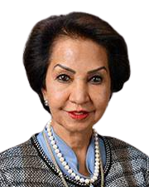
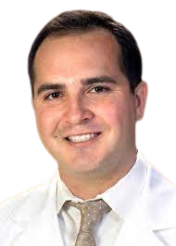
The Closing Session
Matteo Parotto, M.D.
MODERATOR
Maya Suresh, M.D.
Garrett Pacheco, M.D.
Airway Management in the Parturient
Airway Management in Infants and Children

Slide 11
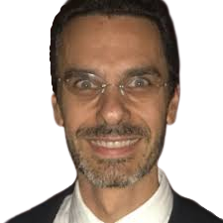
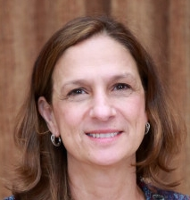
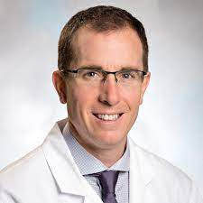
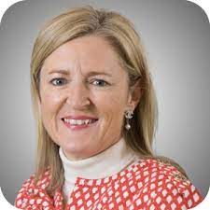
DocMatter Cases
Daniel Perin, M.D.
MODERATOR
Jarrod Mosier, M.D.
Lorraine Foley, M.D.
Calvin Brown, M.D.
Ellen O’Sullivan, M.B.B.S.

Slide 12
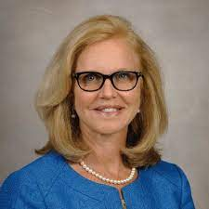
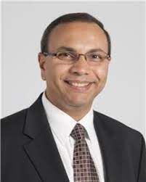
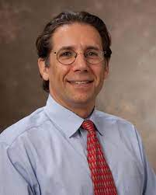
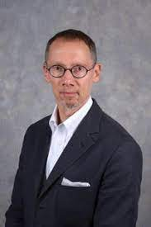
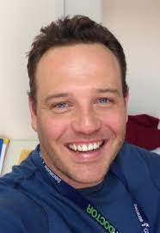
AIRWAY GUIDELINES SESSION
Carin Hagberg, M.D.
MODERATOR
ASA I
ASA II
ASA III
CAFG
PUMA
Basem Abdelmalak, M.D.
Sheila Myatra, M.D.
Will Rosenblatt, M.D.
J. Adam Law, M.D.
Nicholas Chrimes, M.B.B.S.
ASA Decision Tree Tool
Adult Infographic Part 1
ASA Adult Infographic Part 2
ASA Adult Infographic Part 3
Canadian Airway Focus Group
(CAFG) Guidelines
Project for
Universal Management of the Airway (PUMA) Guidelines

Slide 13
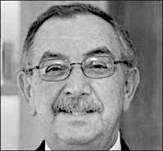
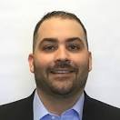
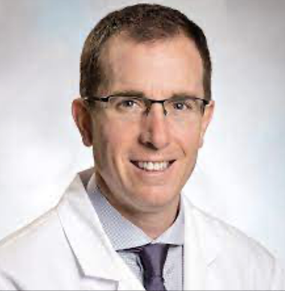
THE RICHARD AGHABABIAN EMERGENCY AIRWAY SESSION
George Kovacs, M.D.
MODERATOR
Richard Aghababian
In Memoriam
David Olvera, NREMT-P
Calvin Brown, III, M.D.
Sheila Myatra, M.D.
Improving Airway Management in the Prehospital Setting
Improving Airway Management in the ED
Improving Airway Management in the ICU

Slide 14

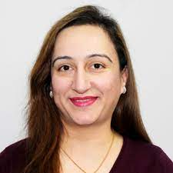

DIFFICULT AIRWAY SOCIETY (DAS) LECTURE:
THE TRAUMATIZED AIRWAY
FAUZIA MIR, M.B.B.S.
St Georges University Hospitals, NHS Foundation Trust
London, United Kingdom

Slide 15

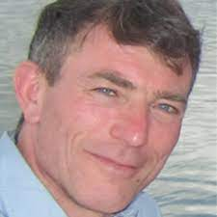

EUROPEAN AIRWAY MANAGEMENT SOCIETY (EAMS) LECTURE
CONTROLLED VENTILATION WITH MINIMAL or NO DEVICE
MICHAEL SELTZ KRISTENSEN, M.D.
Copenhagen University Hospital Copenhagen, Denmark

Slide 16

AIRWAY ON DEMAND
William Rosenblatt, M.D.
COURSE DIRECTOR

Slide 17
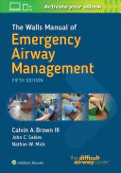
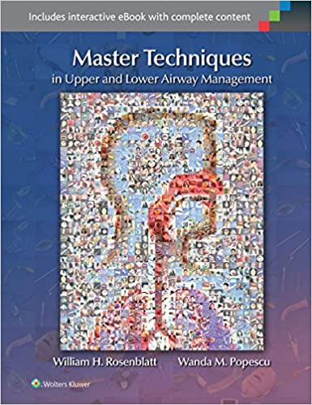
TRACEY STRAKER, M.D.
TRAINEE SESSION
AIRWAY JEOPARDY WITH PRIZES!!!
JEOPARDY!

Slide 18
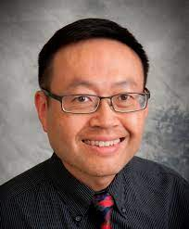
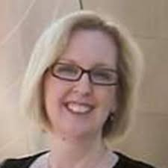
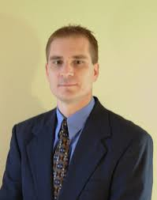
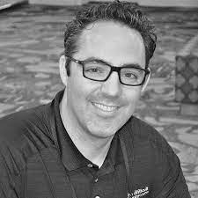
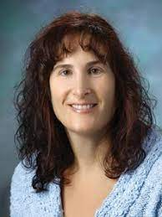
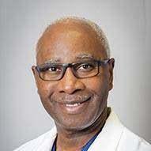
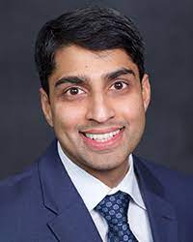
CHALLENGING AIRWAY CASES
David Wong, M.D.
MODERATOR
Tracey Straker, M.D.
Elizabeth Behringer, M.D
Richard Galgon, M.D.
Lauren Berkow, M.D.
Jarrod Mosier, M.D.
Patrick Olomu, M.D.
EXPERT PANEL
Will Rosenblatt, M.D.
Sim Jagannathan, M.D.

